Slide 1
Overview of the Project & Business goals
Are there any products that do not sell well in some locations?
Are there any other patterns in the data that can be identified in each regeion over time?

Slide 2
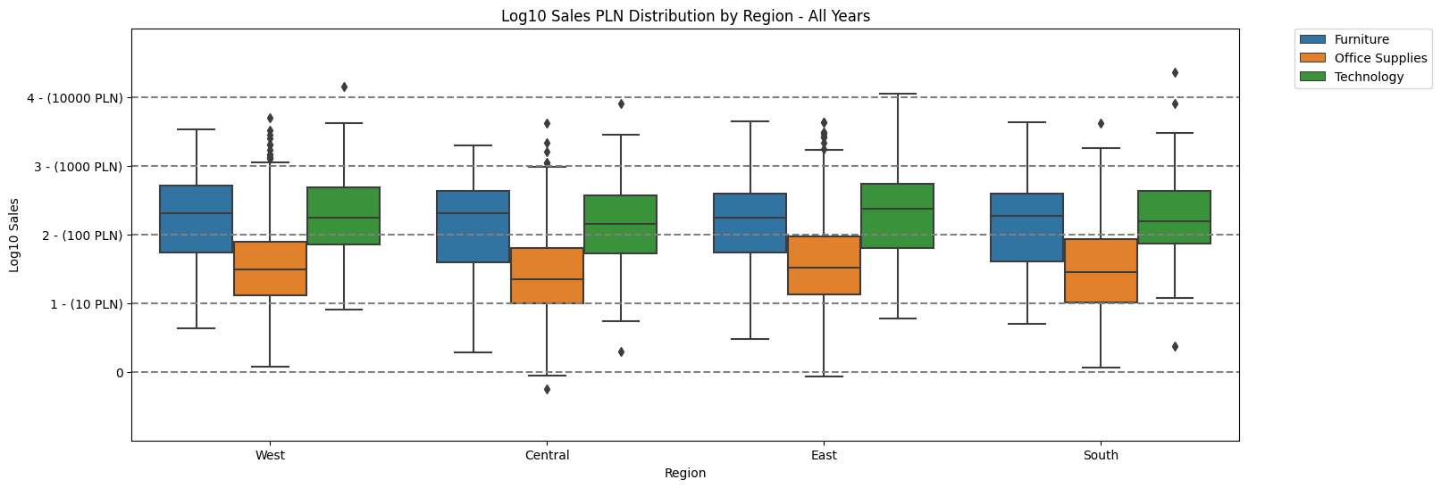
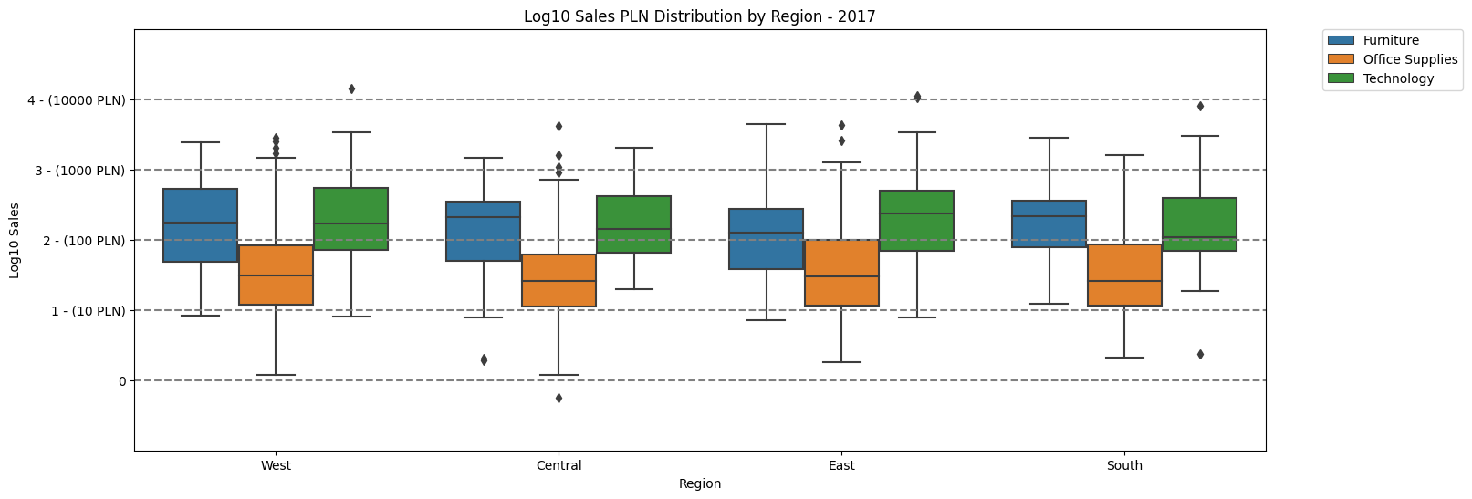
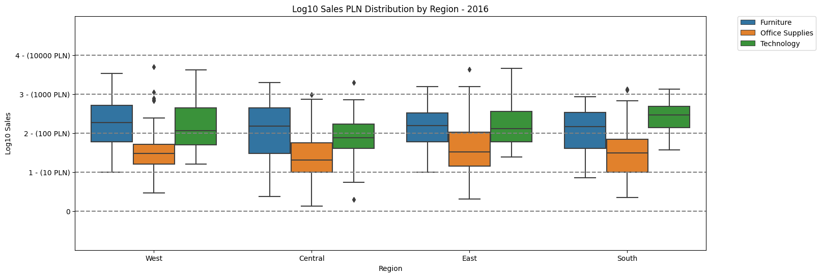
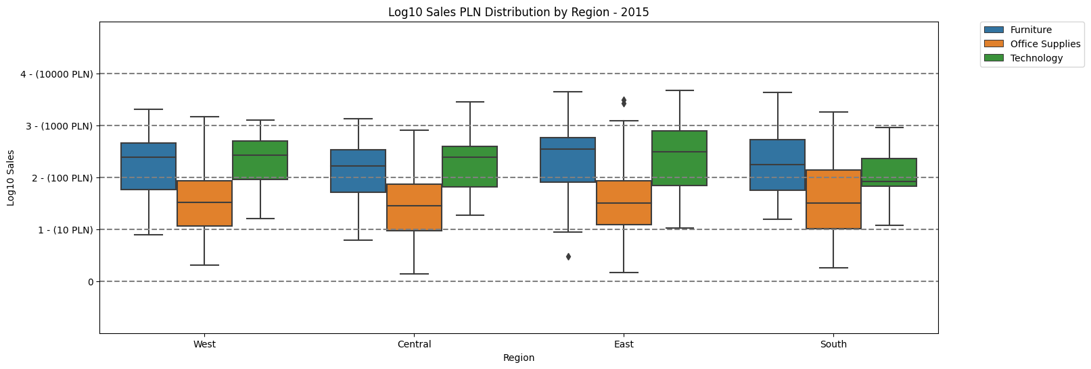
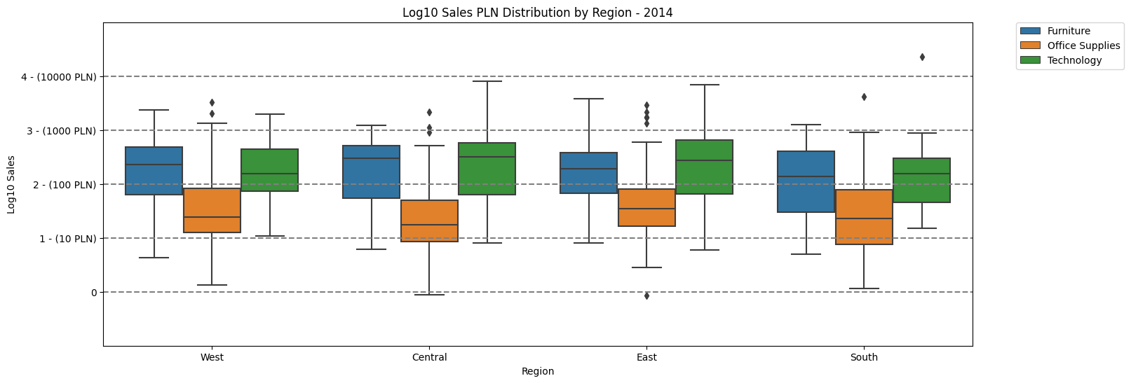
tekst

Slide 3
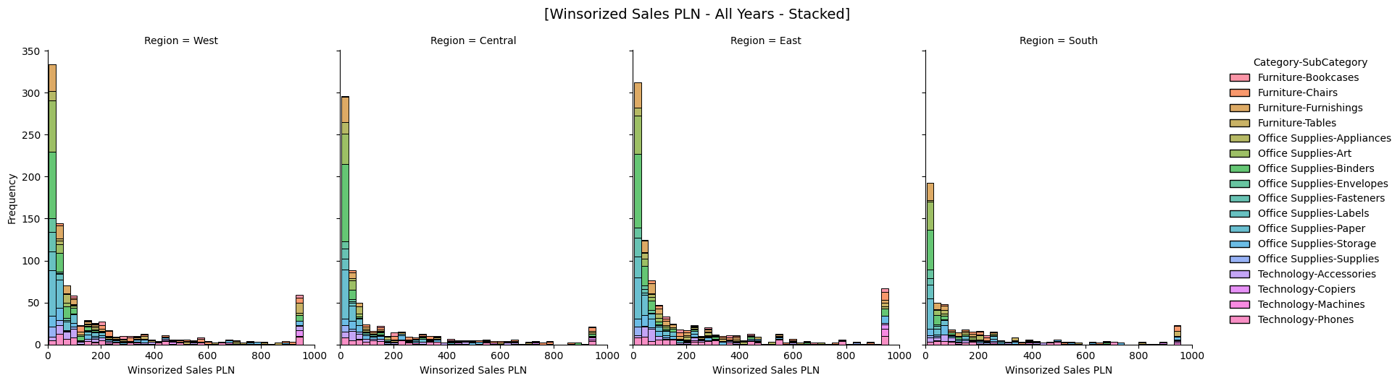
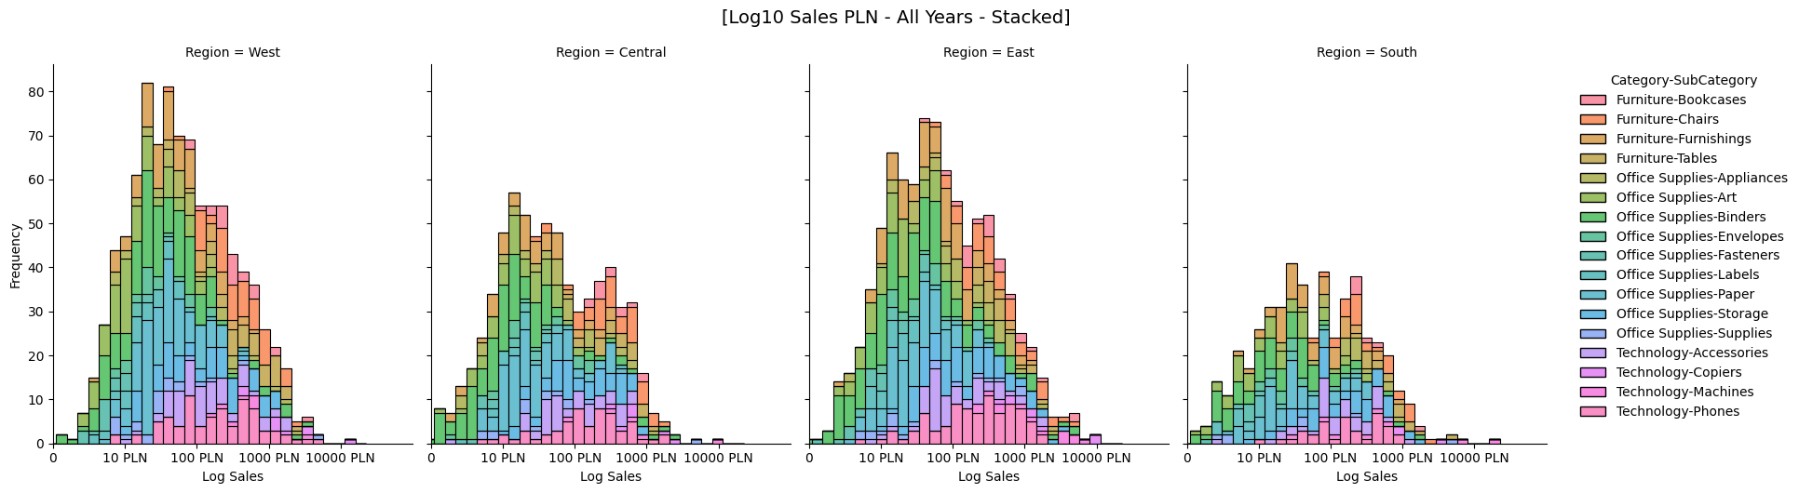
The challenge in capturing differences between prices for a product portfolio consisting of multiple products
tekst
tekst

Slide 4
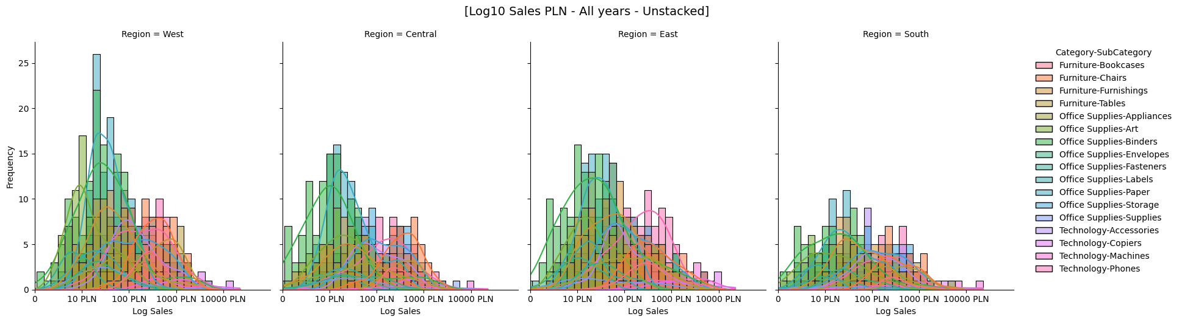
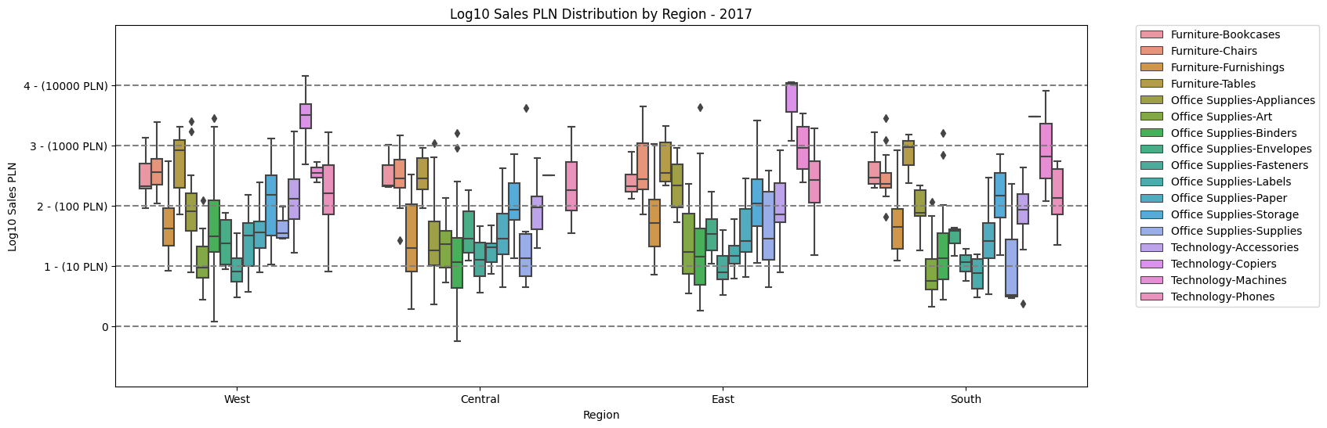
The challenge in capturing differences between prices for a product portfolio consisting of multiple products
tekst
tekst

Slide 5
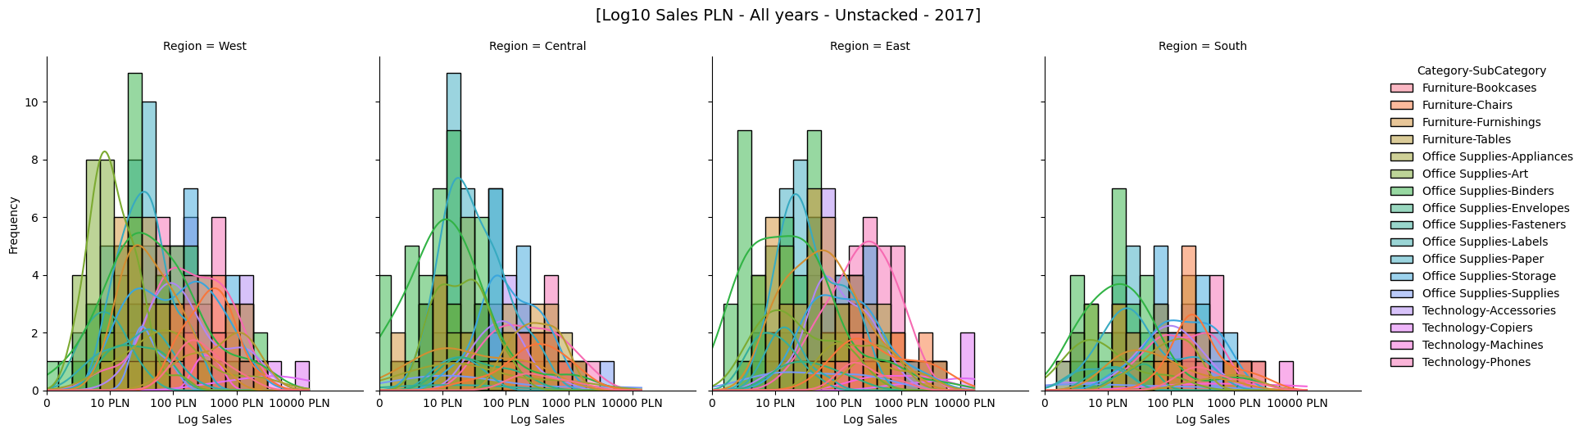
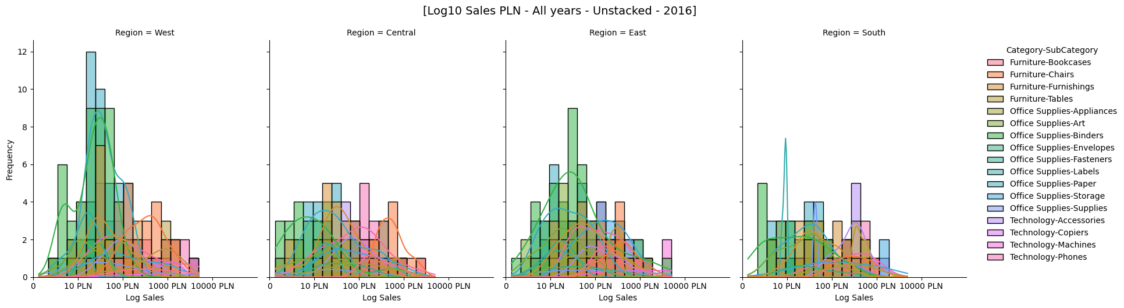
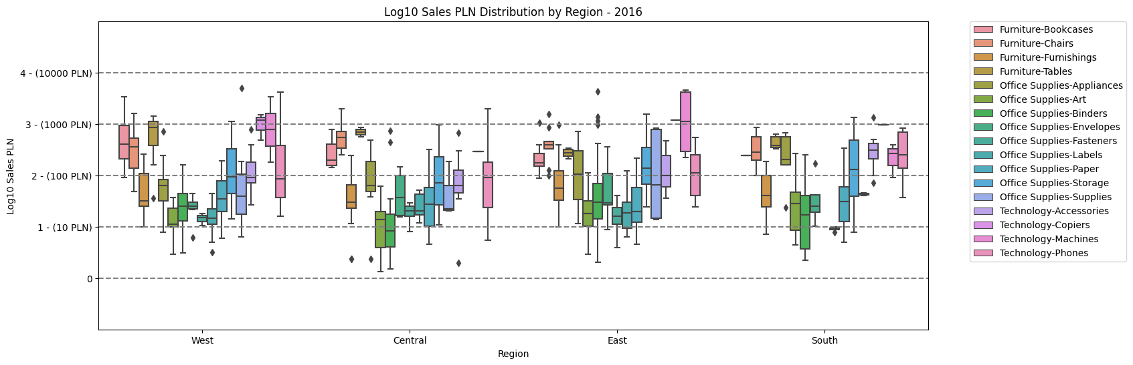
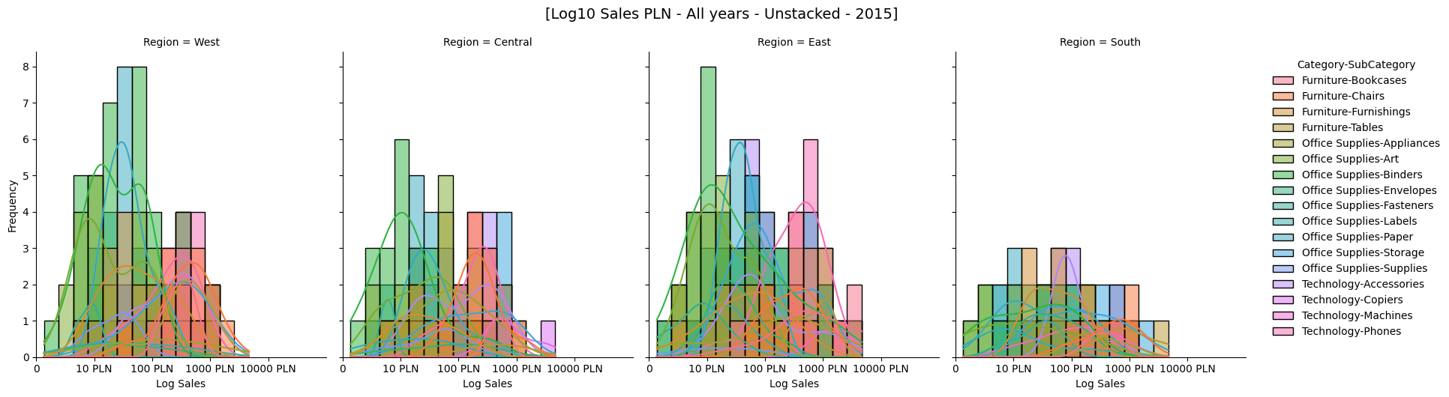
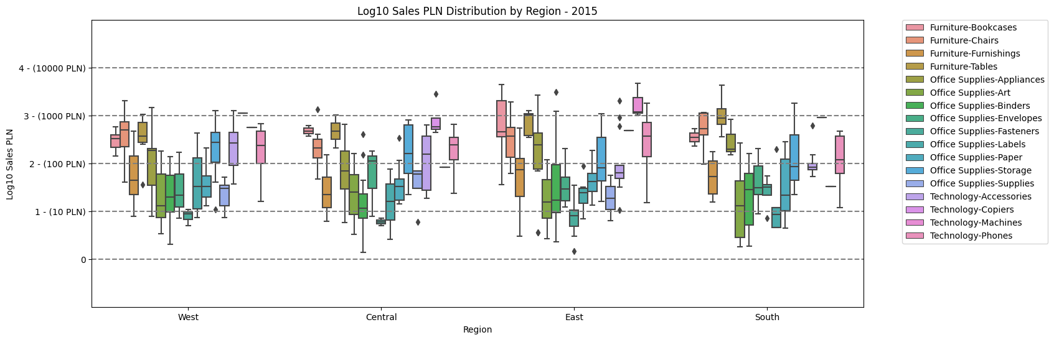
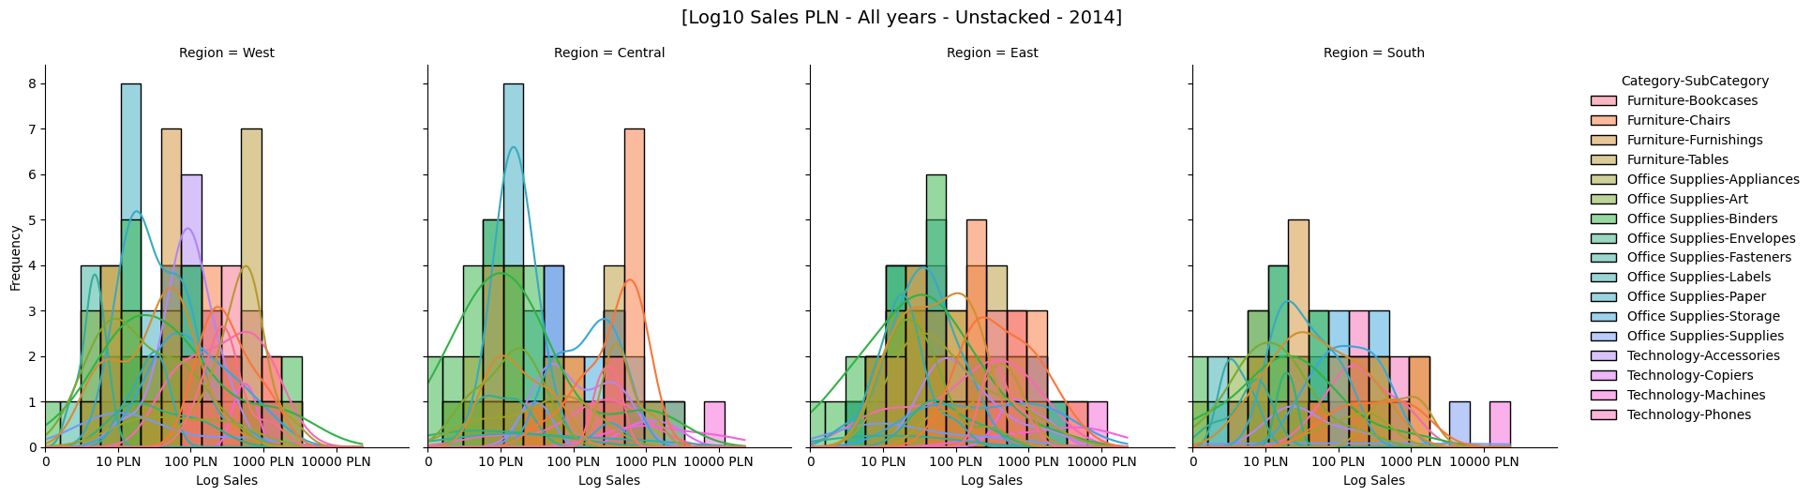
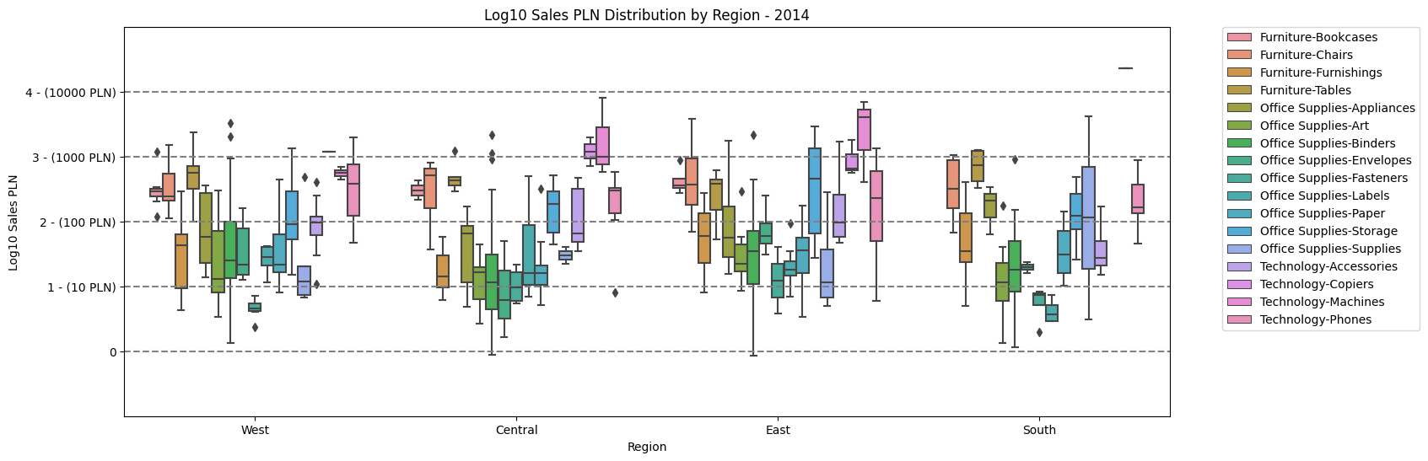
tekst
tekst
tekst
tekst

Slide 6
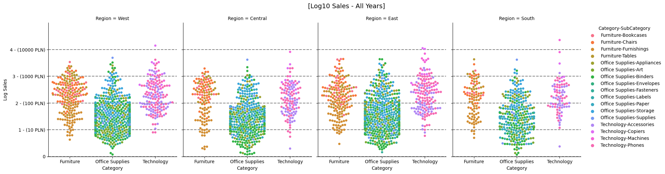
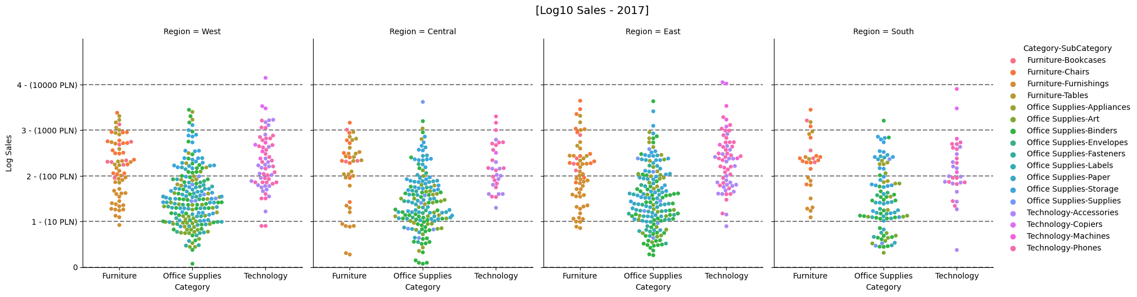
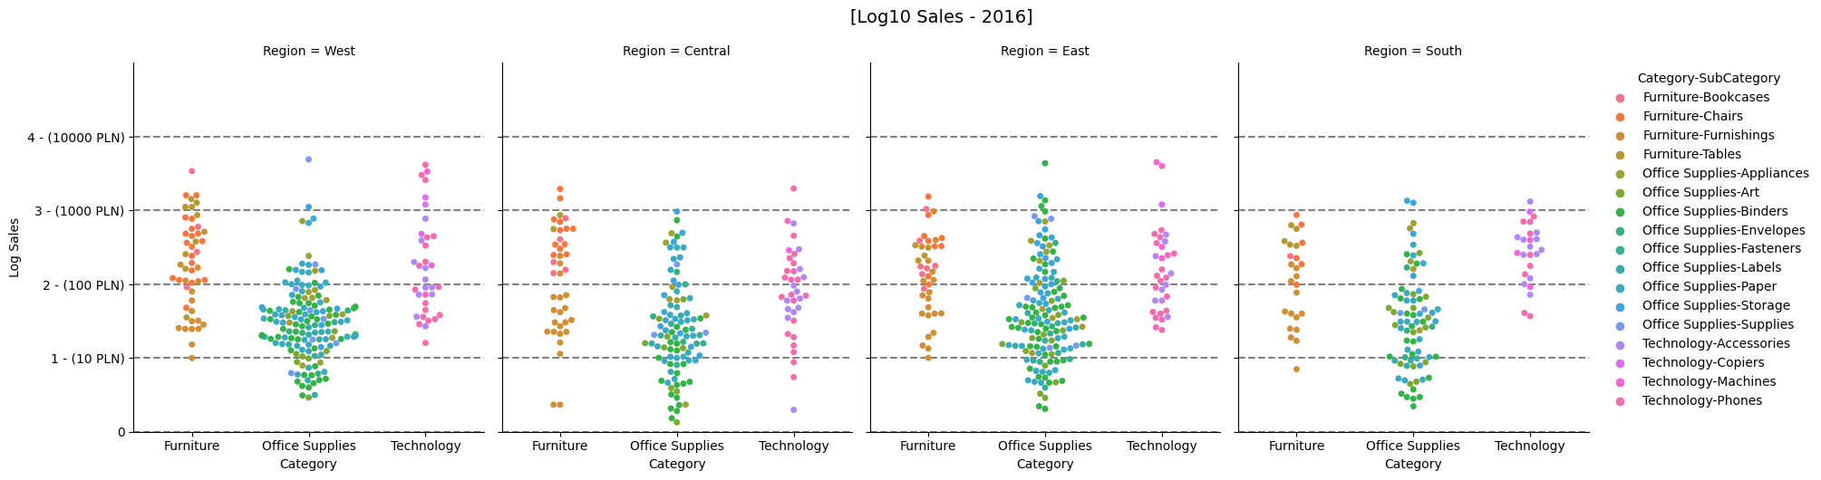
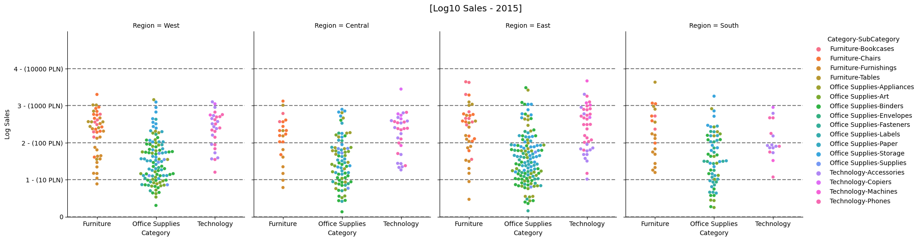
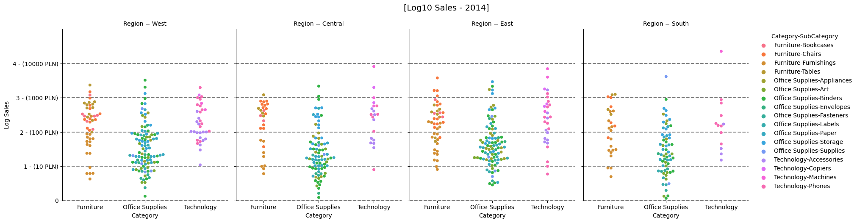
tekst

Slide 7
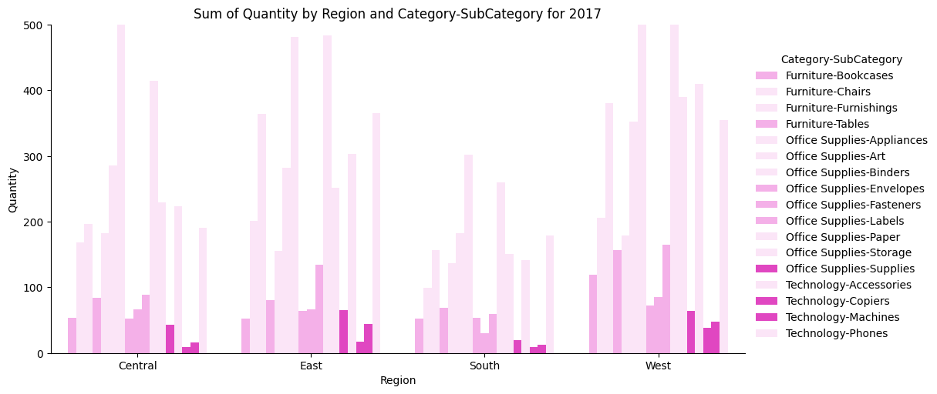
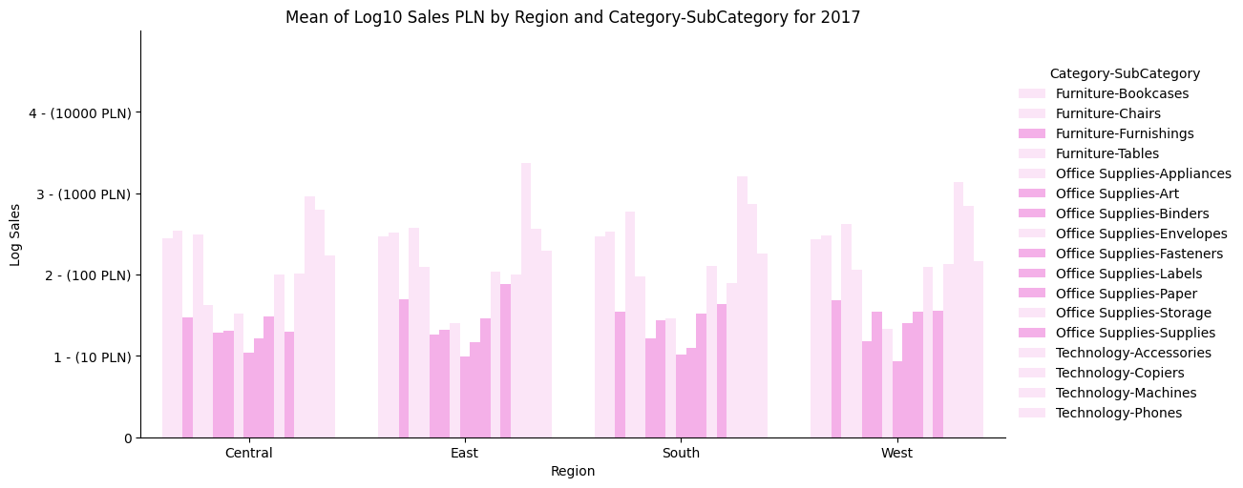
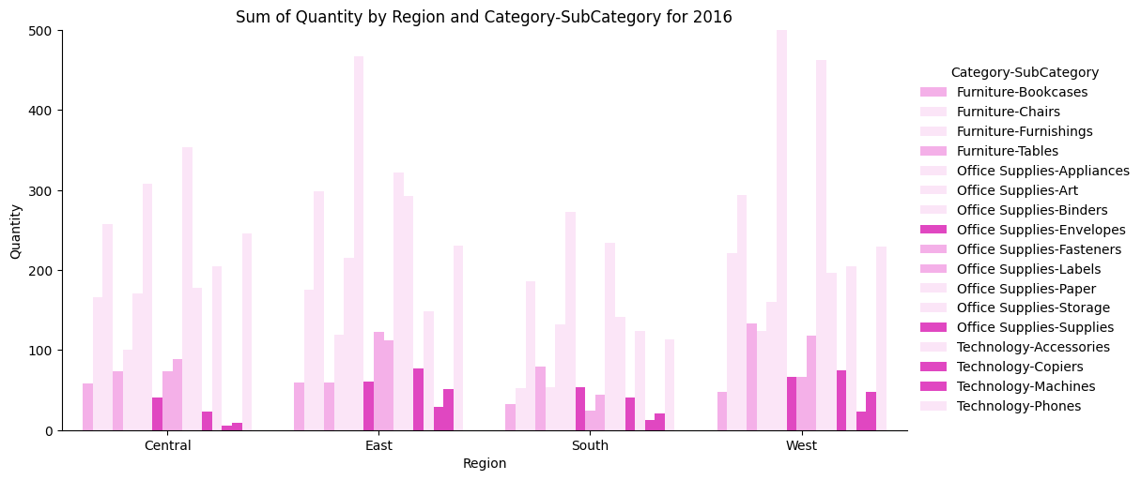
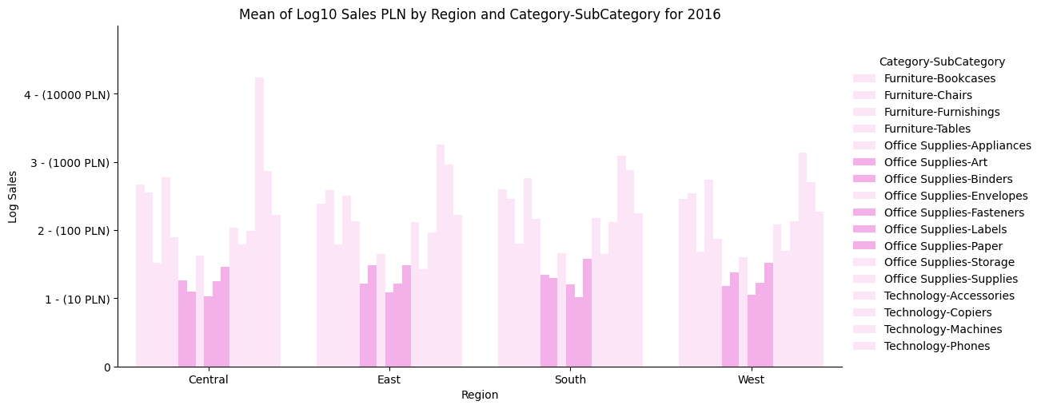
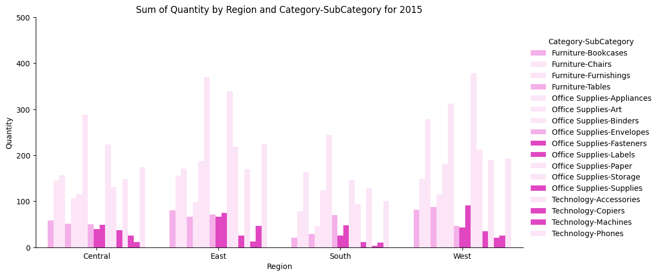
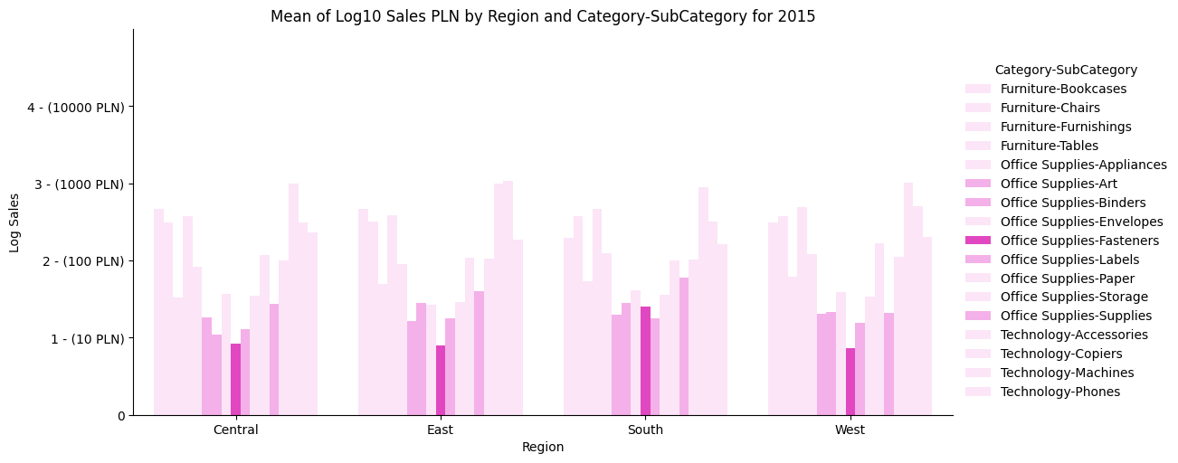
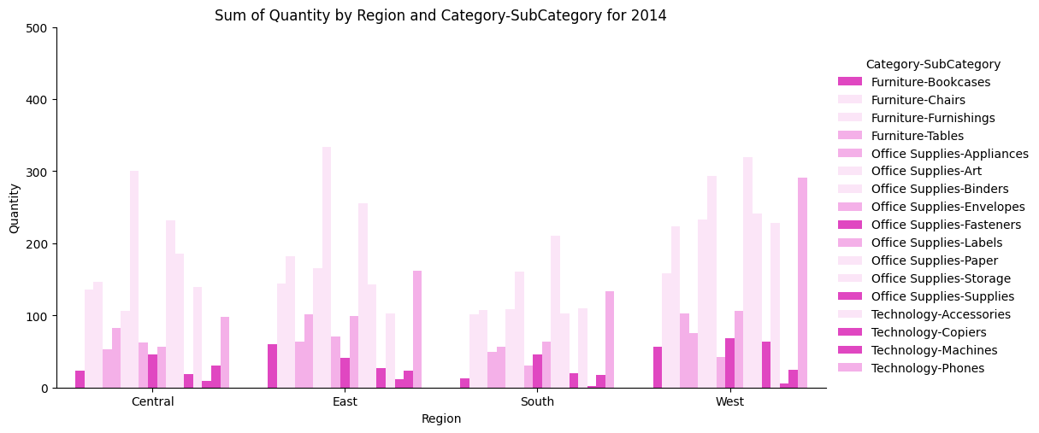
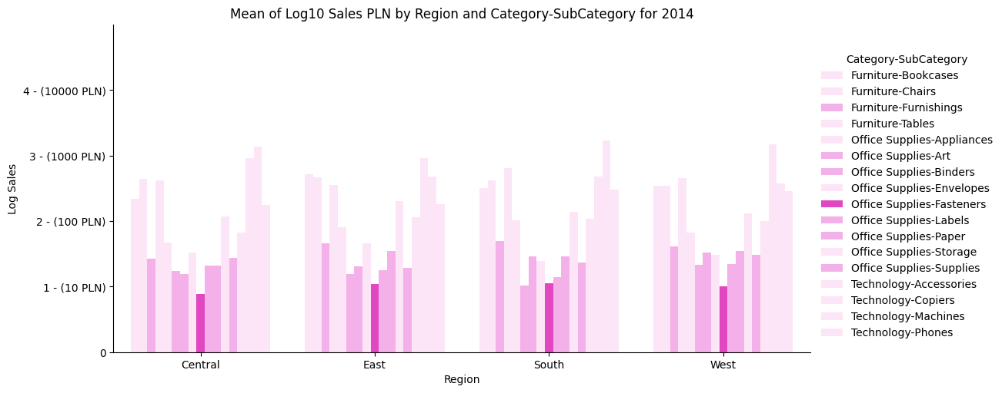
tekst
tekst
tekst
tekst

Slide 8
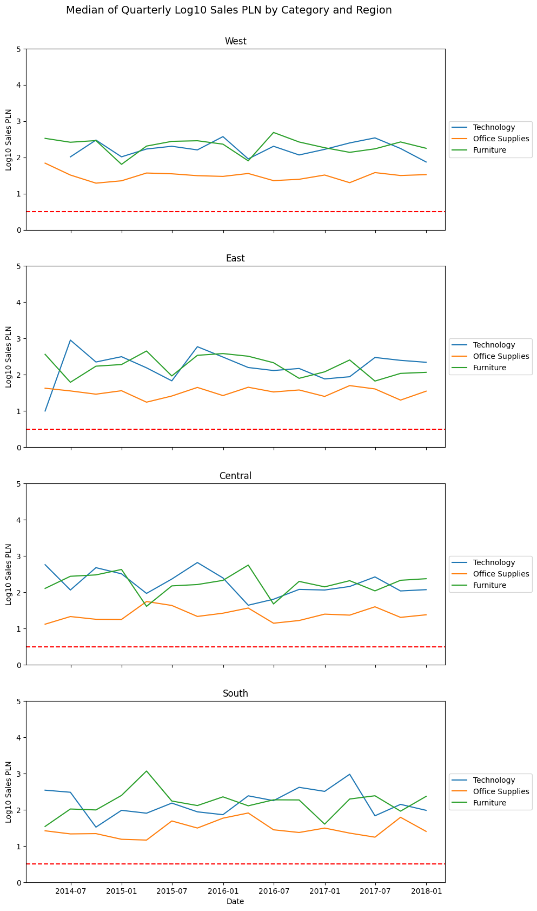
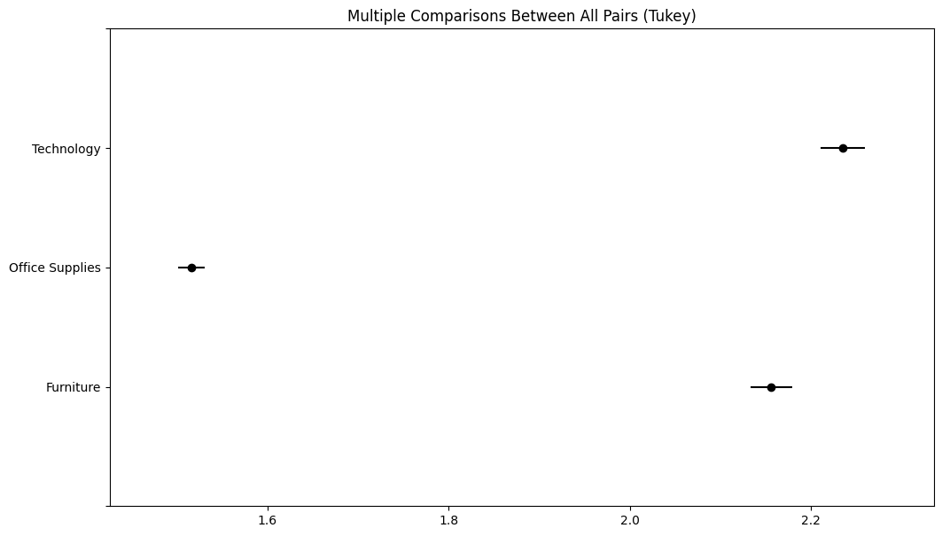
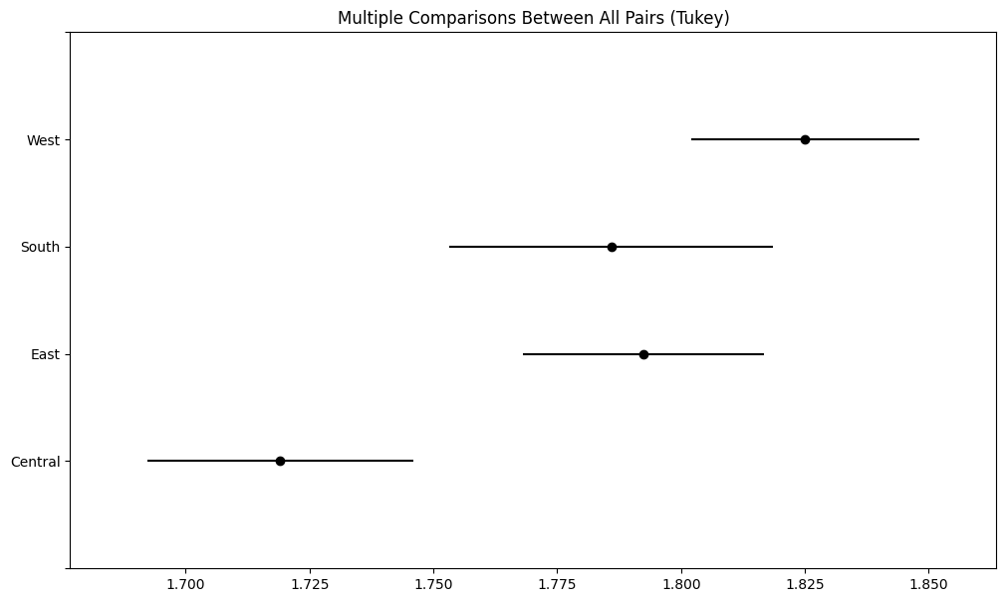

Slide 9
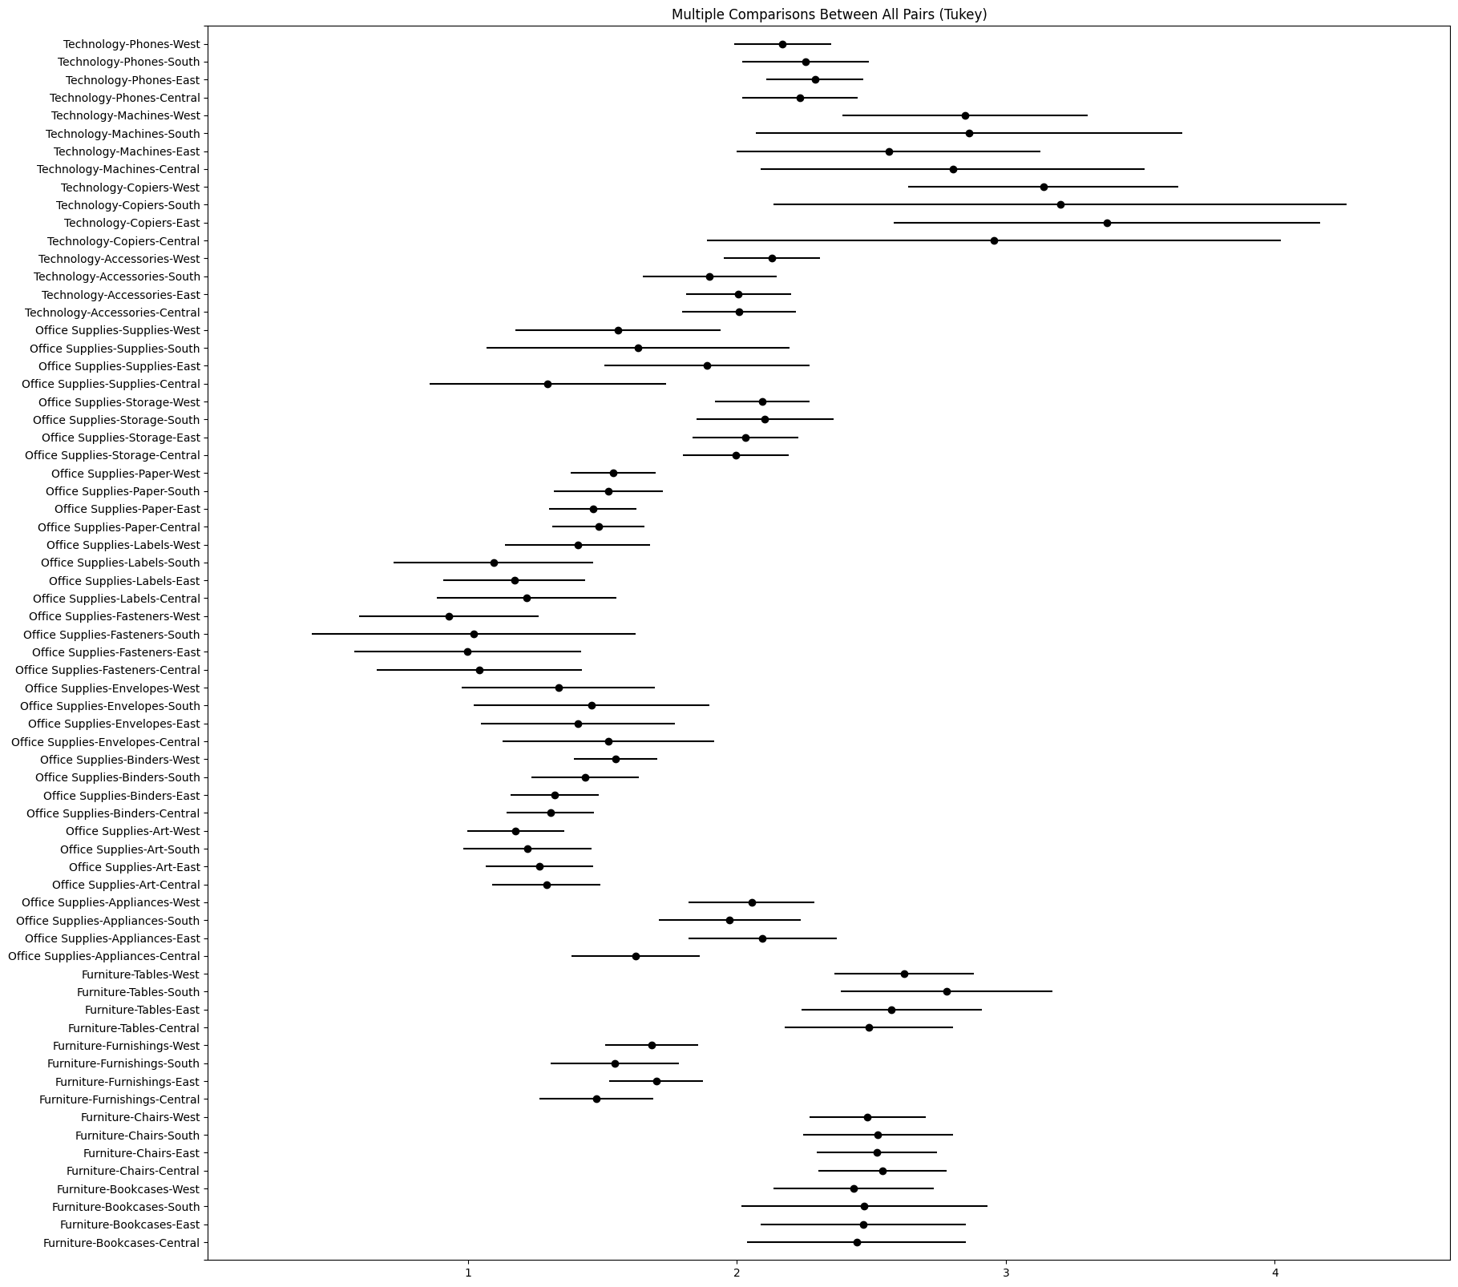

Slide 10
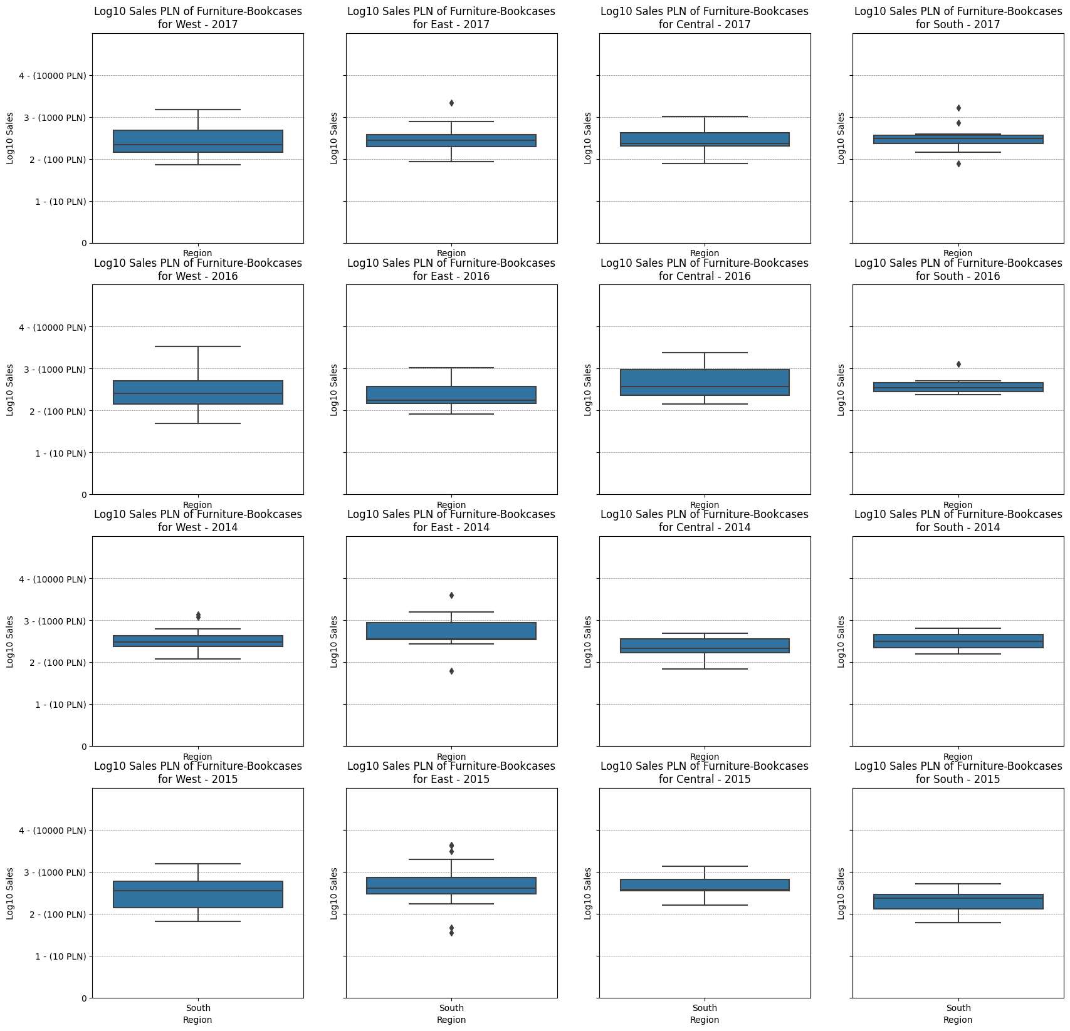
group1 | group2 | meandiff | p-adj | lower | upper | reject
Furniture-Bookcases-Central | Furniture-Bookcases-East | 0.0235 | 1.0 | -0.7514 | 0.7984 | False
Furniture-Bookcases-Central | Furniture-Bookcases-South | 0.0281 | 1.0 | -0.814 | 0.8702 | False
Furniture-Bookcases-Central | Furniture-Bookcases-West | -0.0119 | 1.0 | -0.7143 | 0.6904 | False
Furniture-Bookcases-East | Furniture-Bookcases-South | 0.0046 | 1.0 | -0.8163 | 0.8255 | False
Furniture-Bookcases-East | Furniture-Bookcases-West | -0.0355 | 1.0 | -0.7122 | 0.6413 | False
Furniture-Bookcases-South | Furniture-Bookcases-West | -0.04 | 1.0 | -0.7928 | 0.7127 | False

Slide 11
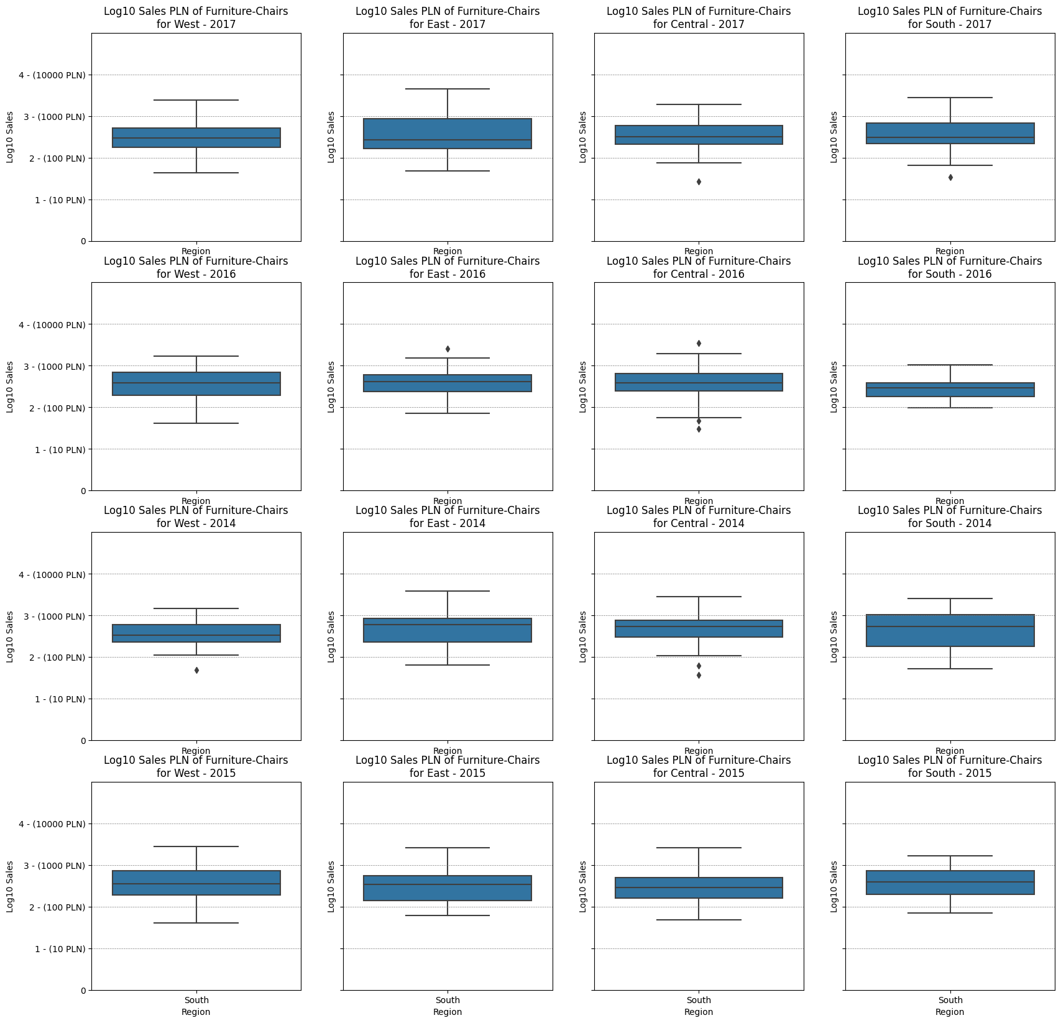
group1 | group2 | meandiff | p-adj | lower | upper | reject
Furniture-Chairs-Central | Furniture-Chairs-East | -0.0214 | 1.0 | -0.4759 | 0.433 | False
Furniture-Chairs-Central | Furniture-Chairs-South | -0.0179 | 1.0 | -0.5324 | 0.4966 | False
Furniture-Chairs-Central | Furniture-Chairs-West | -0.0571 | 1.0 | -0.5023 | 0.3882 | False
Furniture-Chairs-East | Furniture-Chairs-South | 0.0036 | 1.0 | -0.4965 | 0.5037 | False
Furniture-Chairs-East | Furniture-Chairs-West | -0.0356 | 1.0 | -0.4642 | 0.3929 | False
Furniture-Chairs-South | Furniture-Chairs-West | -0.0392 | 1.0 | -0.5309 | 0.4526 | False

Slide 12
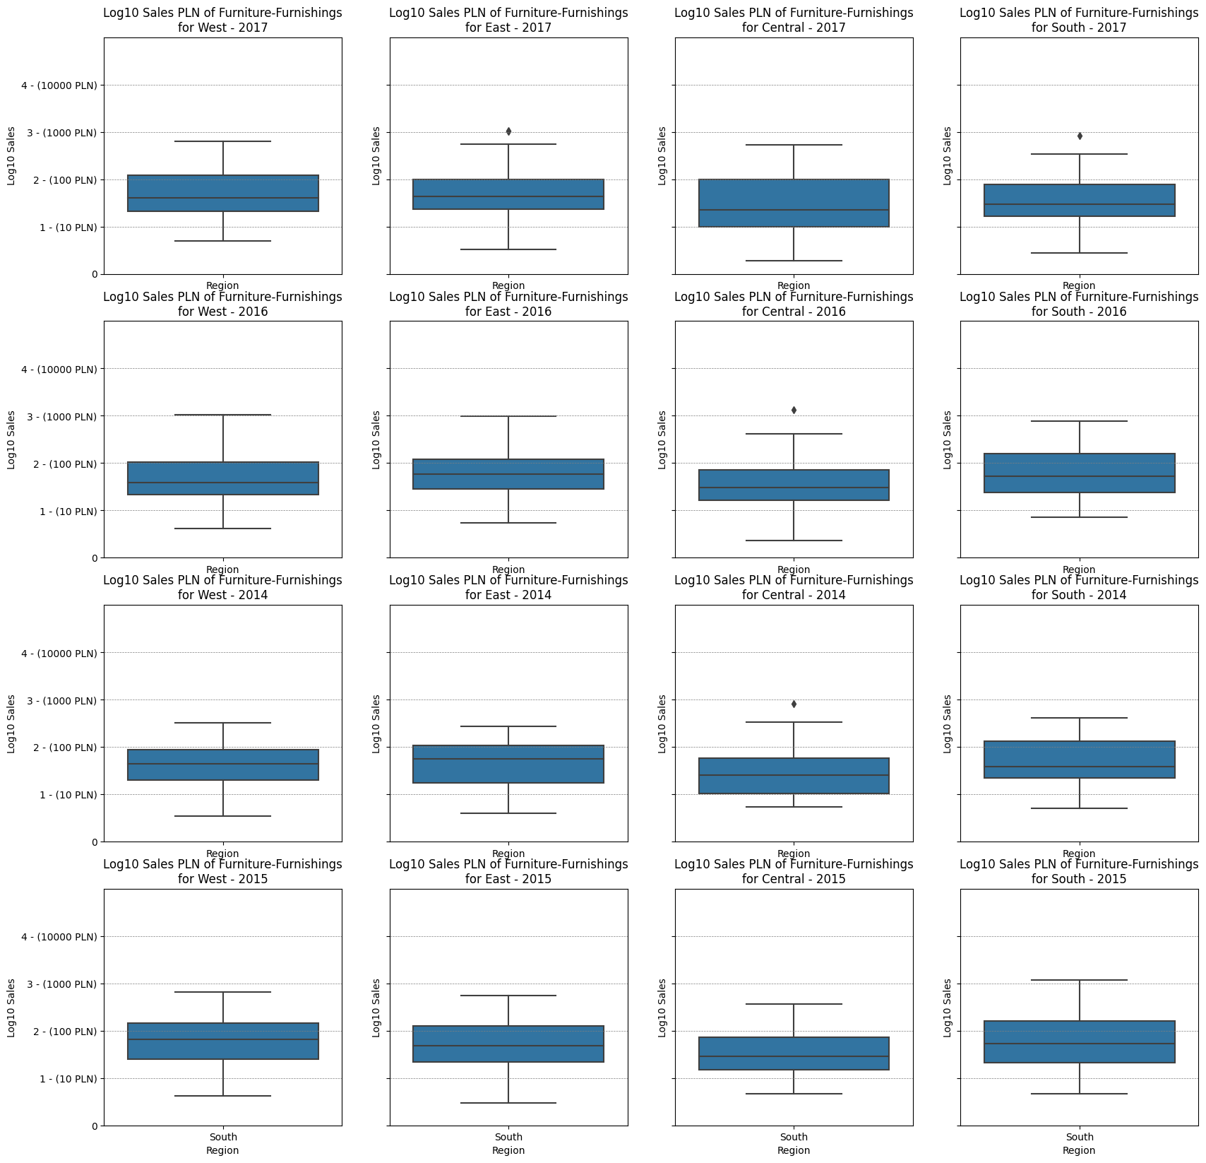
group1 | group2 | meandiff | p-adj | lower | upper | reject
Furniture-Furnishings-Central | Furniture-Furnishings-East | 0.223 | 0.9806 | -0.1413 | 0.5874 | False
Furniture-Furnishings-Central | Furniture-Furnishings-South | 0.0685 | 1.0 | -0.3719 | 0.5089 | False
Furniture-Furnishings-Central | Furniture-Furnishings-West | 0.206 | 0.9959 | -0.1564 | 0.5684 | False
Furniture-Furnishings-East | Furniture-Furnishings-South | -0.1546 | 1.0 | -0.5545 | 0.2454 | False
Furniture-Furnishings-East | Furniture-Furnishings-West | -0.0171 | 1.0 | -0.3291 | 0.295 | False
Furniture-Furnishings-South | Furniture-Furnishings-West | 0.1375 | 1.0 | -0.2607 | 0.5357 | False

Slide 13
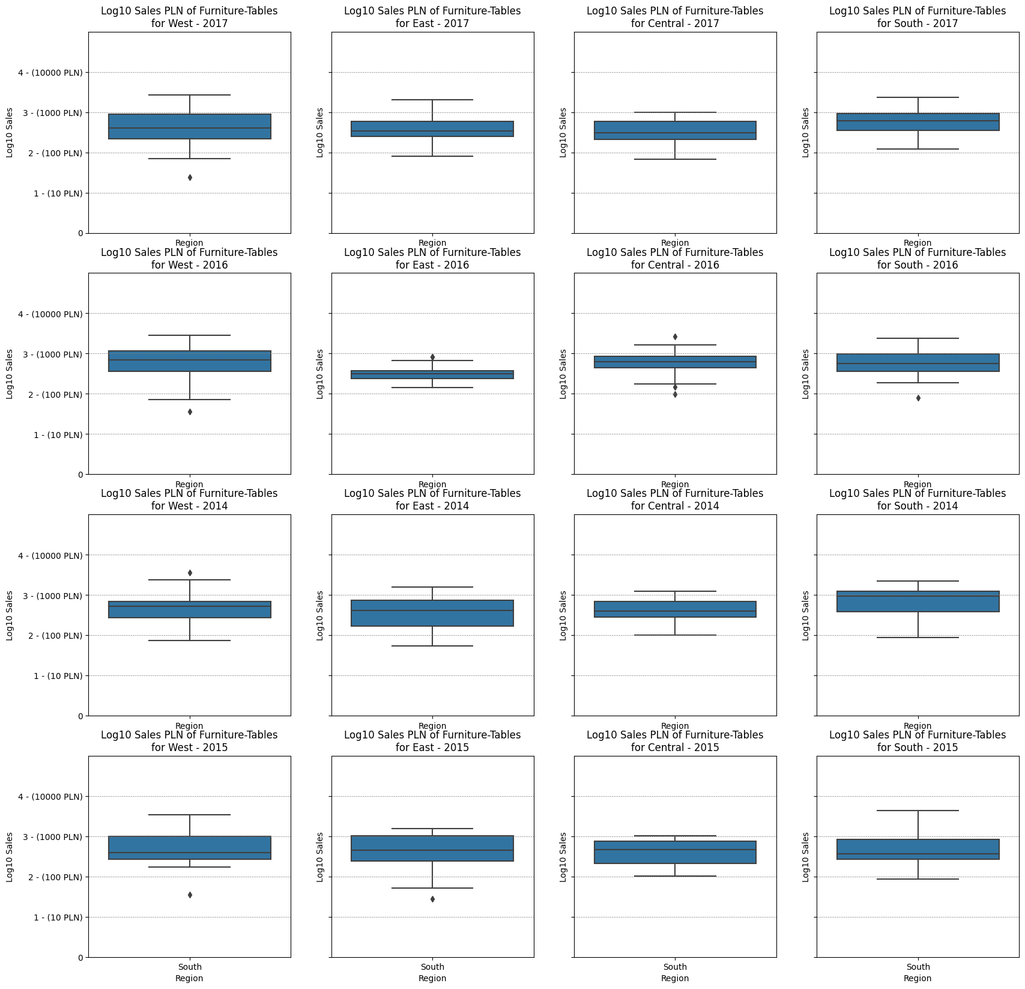
group1 | group2 | meandiff | p-adj | lower | upper | reject
Furniture-Tables-Central | Furniture-Tables-East | 0.0849 | 1.0 | -0.5607 | 0.7304 | False
Furniture-Tables-Central | Furniture-Tables-South | 0.2887 | 1.0 | -0.4147 | 0.9921 | False
Furniture-Tables-Central | Furniture-Tables-West | 0.1315 | 1.0 | -0.4425 | 0.7055 | False
Furniture-Tables-East | Furniture-Tables-South | 0.2039 | 1.0 | -0.5175 | 0.9252 | False
Furniture-Tables-East | Furniture-Tables-West | 0.0467 | 1.0 | -0.5491 | 0.6425 | False
Furniture-Tables-South | Furniture-Tables-West | -0.1572 | 1.0 | -0.8152 | 0.5009 | False

Slide 14
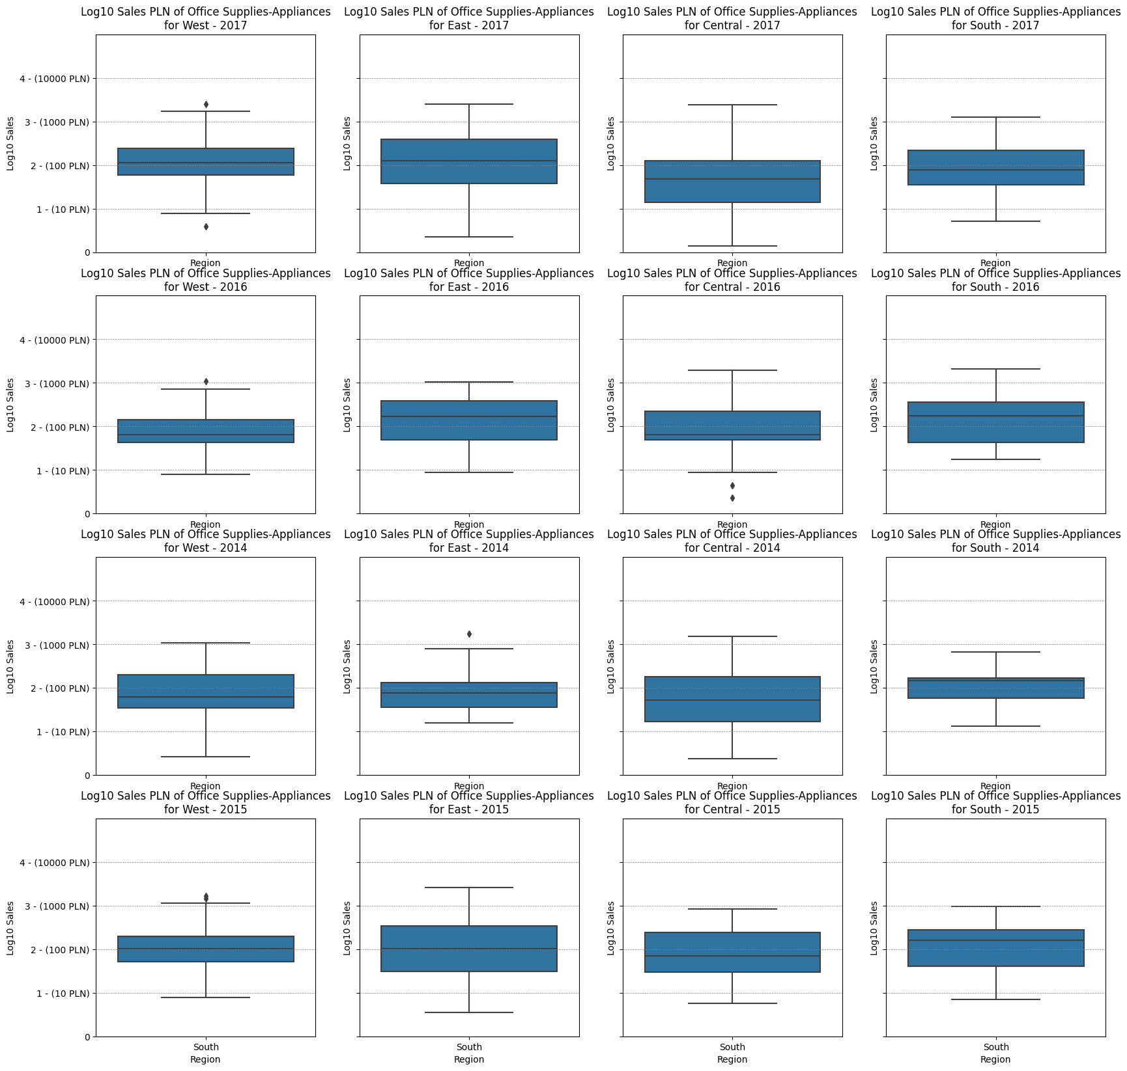
group1 | group2 | meandiff | p-adj | lower | upper | reject
Office Supplies-Appliances-Central | Office Supplies-Appliances-East | 0.4709 | 0.1449 | -0.0391 | 0.981 | False
Office Supplies-Appliances-Central | Office Supplies-Appliances-South | 0.348 | 0.8511 | -0.1501 | 0.846 | False
Office Supplies-Appliances-Central | Office Supplies-Appliances-West | 0.4307 | 0.1409 | -0.0347 | 0.896 | False
Office Supplies-Appliances-East | Office Supplies-Appliances-South | -0.1229 | 1.0 | -0.6587 | 0.4128 | False
Office Supplies-Appliances-East | Office Supplies-Appliances-West | -0.0403 | 1.0 | -0.5458 | 0.4653 | False
Office Supplies-Appliances-South | Office Supplies-Appliances-West | 0.0827 | 1.0 | -0.4107 | 0.5761 | False

Slide 15
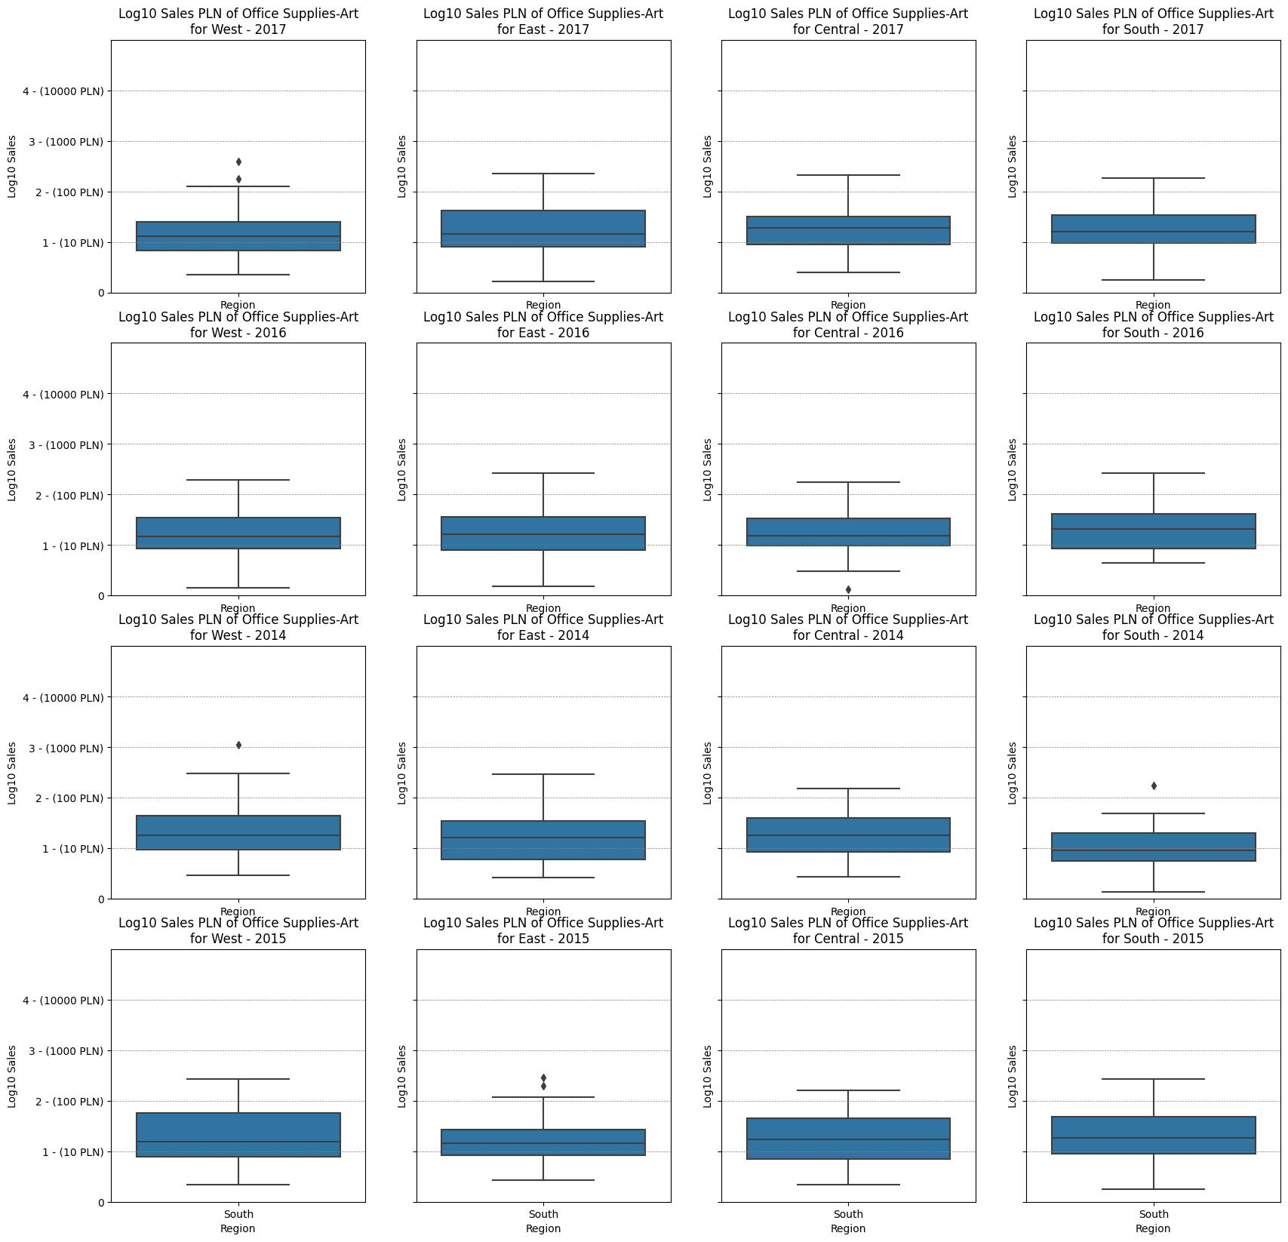
group1 | group2 | meandiff | p-adj | lower | upper | reject
Office Supplies-Art-Central | Office Supplies-Art-East | -0.0259 | 1.0 | -0.4072 | 0.3553 | False
Office Supplies-Art-Central | Office Supplies-Art-South | -0.071 | 1.0 | -0.5002 | 0.3583 | False
Office Supplies-Art-Central | Office Supplies-Art-West | -0.114 | 1.0 | -0.4699 | 0.2419 | False
Office Supplies-Art-East | Office Supplies-Art-South | -0.045 | 1.0 | -0.4719 | 0.3818 | False
Office Supplies-Art-East | Office Supplies-Art-West | -0.0881 | 1.0 | -0.4411 | 0.2649 | False
Office Supplies-Art-South | Office Supplies-Art-West | -0.043 | 1.0 | -0.4475 | 0.3614 | False

Slide 16
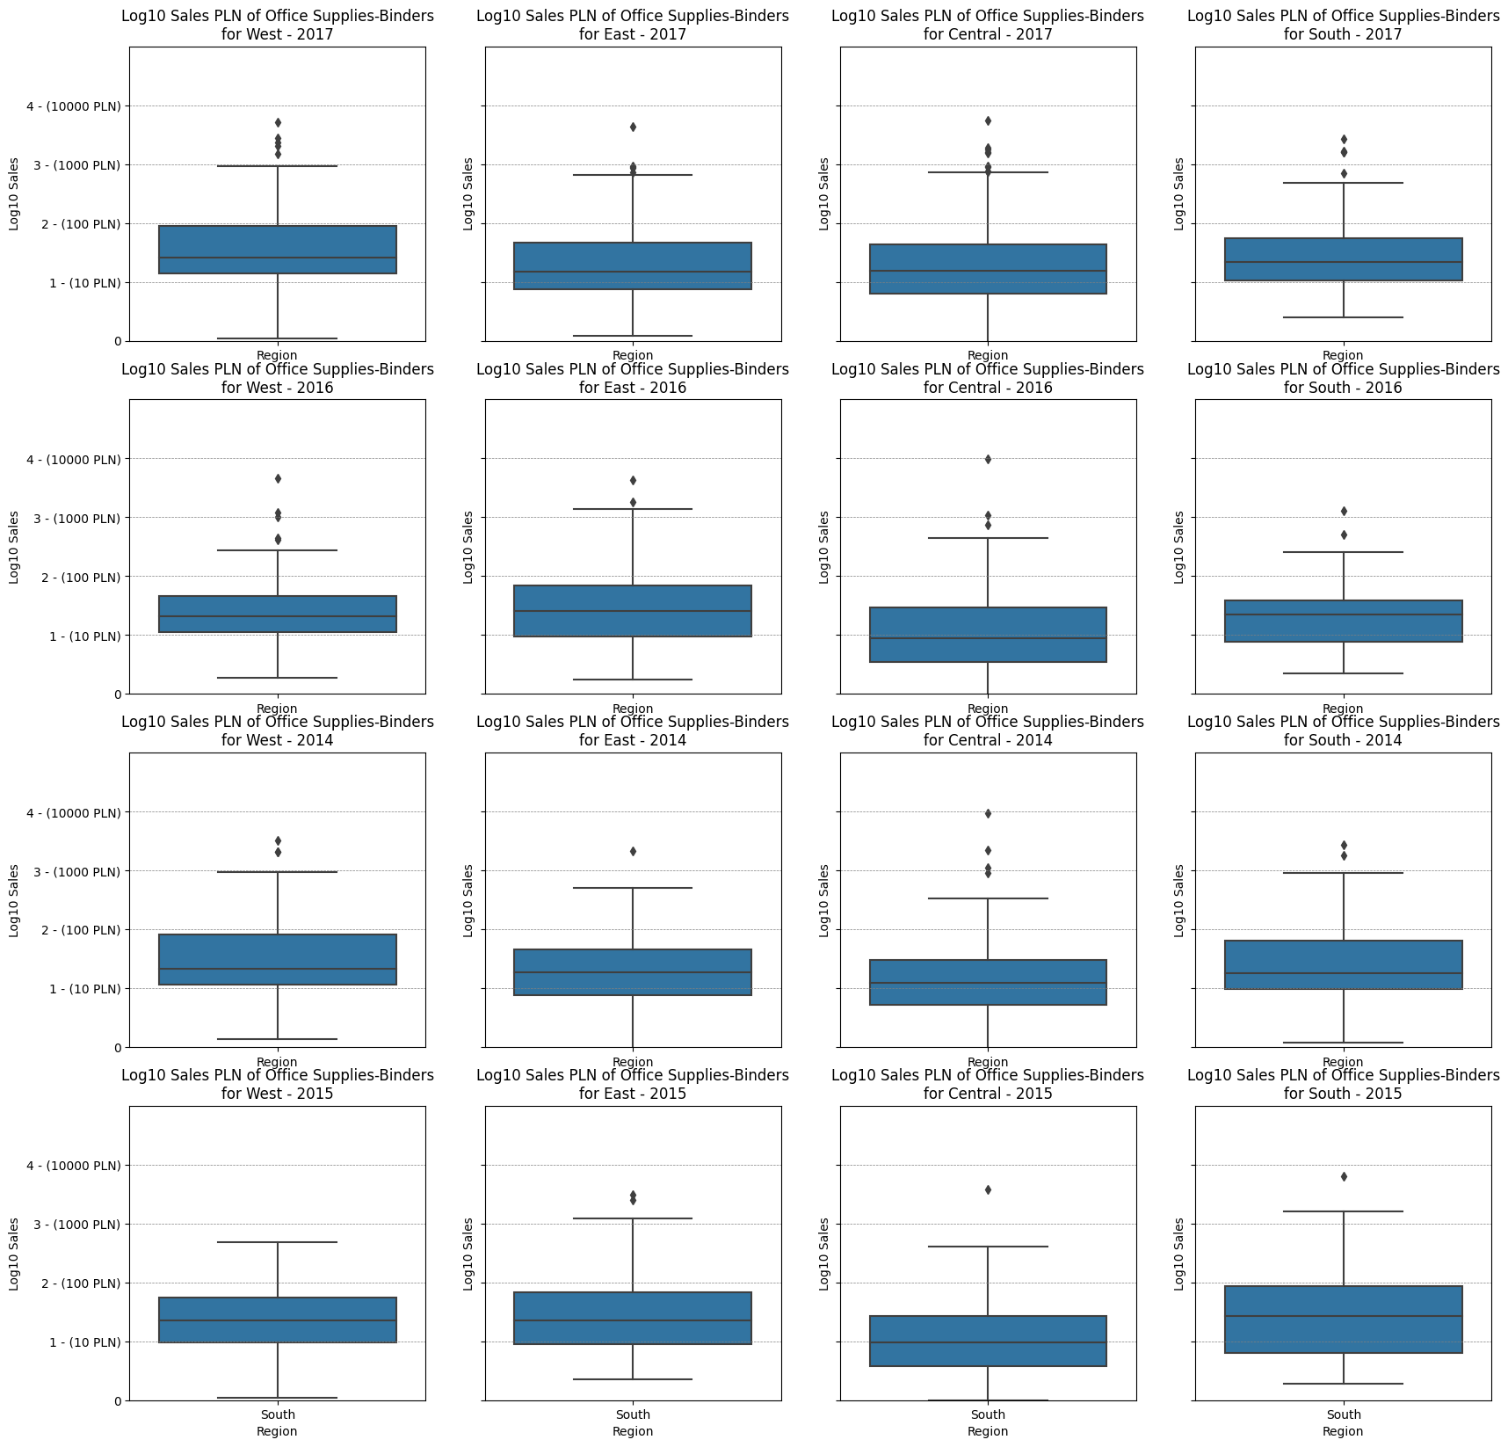
group1 | group2 | meandiff | p-adj | lower | upper | reject
Office Supplies-Binders-Central | Office Supplies-Binders-East | 0.0156 | 1.0 | -0.262 | 0.2932 | False
Office Supplies-Binders-Central | Office Supplies-Binders-South | 0.1289 | 1.0 | -0.203 | 0.4609 | False
Office Supplies-Binders-Central | Office Supplies-Binders-West | 0.2424 | 0.1499 | -0.0209 | 0.5058 | False
Office Supplies-Binders-East | Office Supplies-Binders-South | 0.1133 | 1.0 | -0.2186 | 0.4453 | False
Office Supplies-Binders-East | Office Supplies-Binders-West | 0.2268 | 0.2932 | -0.0365 | 0.4902 | False
Office Supplies-Binders-South | Office Supplies-Binders-West | 0.1135 | 1.0 | -0.2066 | 0.4336 | False

Slide 17
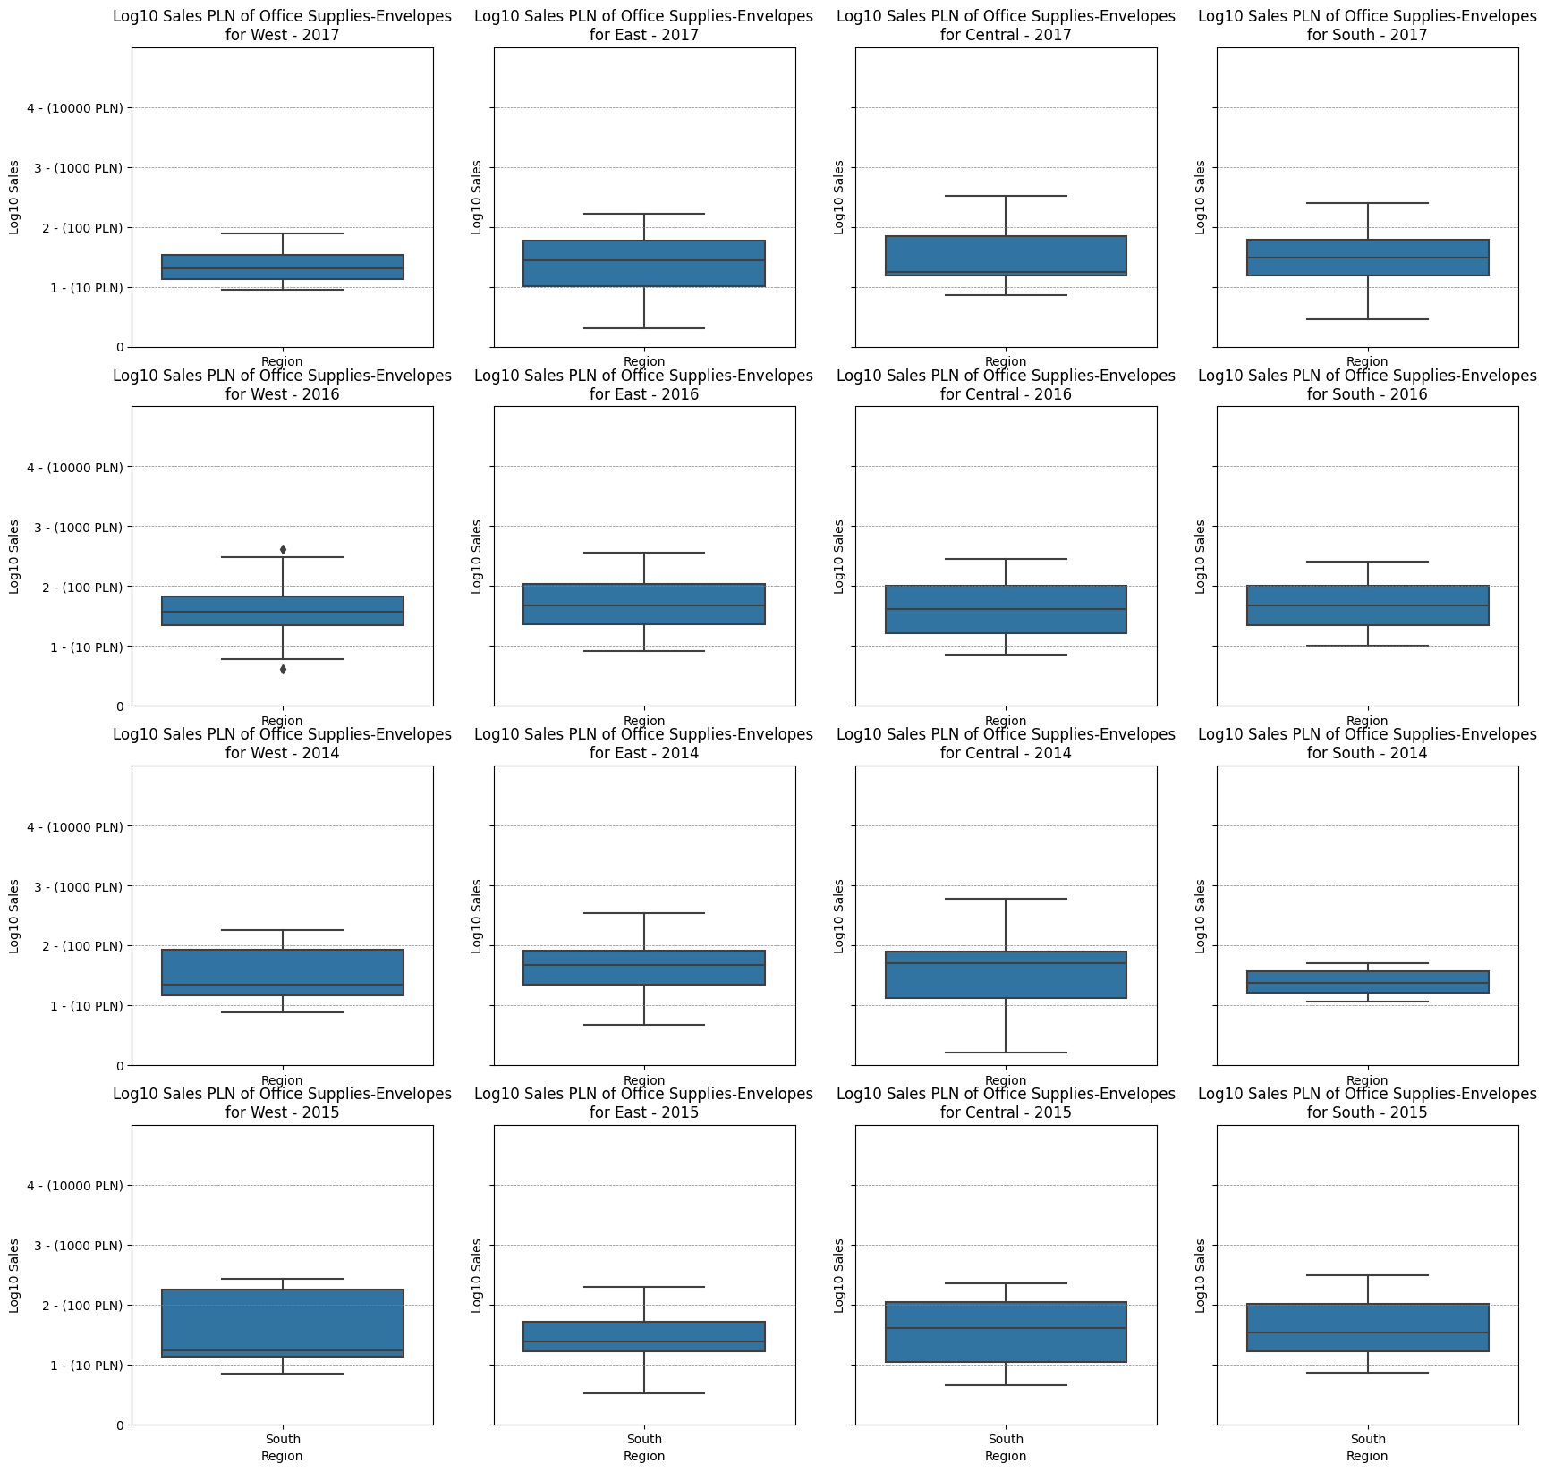
group1 | group2 | meandiff | p-adj | lower | upper | reject
Office Supplies-Envelopes-Central | Office Supplies-Envelopes-East | -0.1136 | 1.0 | -0.8576 | 0.6303 | False
Office Supplies-Envelopes-Central | Office Supplies-Envelopes-South | -0.0636 | 1.0 | -0.8775 | 0.7504 | False
Office Supplies-Envelopes-Central | Office Supplies-Envelopes-West | -0.1867 | 1.0 | -0.9307 | 0.5573 | False
Office Supplies-Envelopes-East | Office Supplies-Envelopes-South | 0.0501 | 1.0 | -0.7358 | 0.836 | False
Office Supplies-Envelopes-East | Office Supplies-Envelopes-West | -0.073 | 1.0 | -0.7862 | 0.6401 | False
Office Supplies-Envelopes-South | Office Supplies-Envelopes-West | -0.1231 | 1.0 | -0.909 | 0.6628 | False

Slide 18
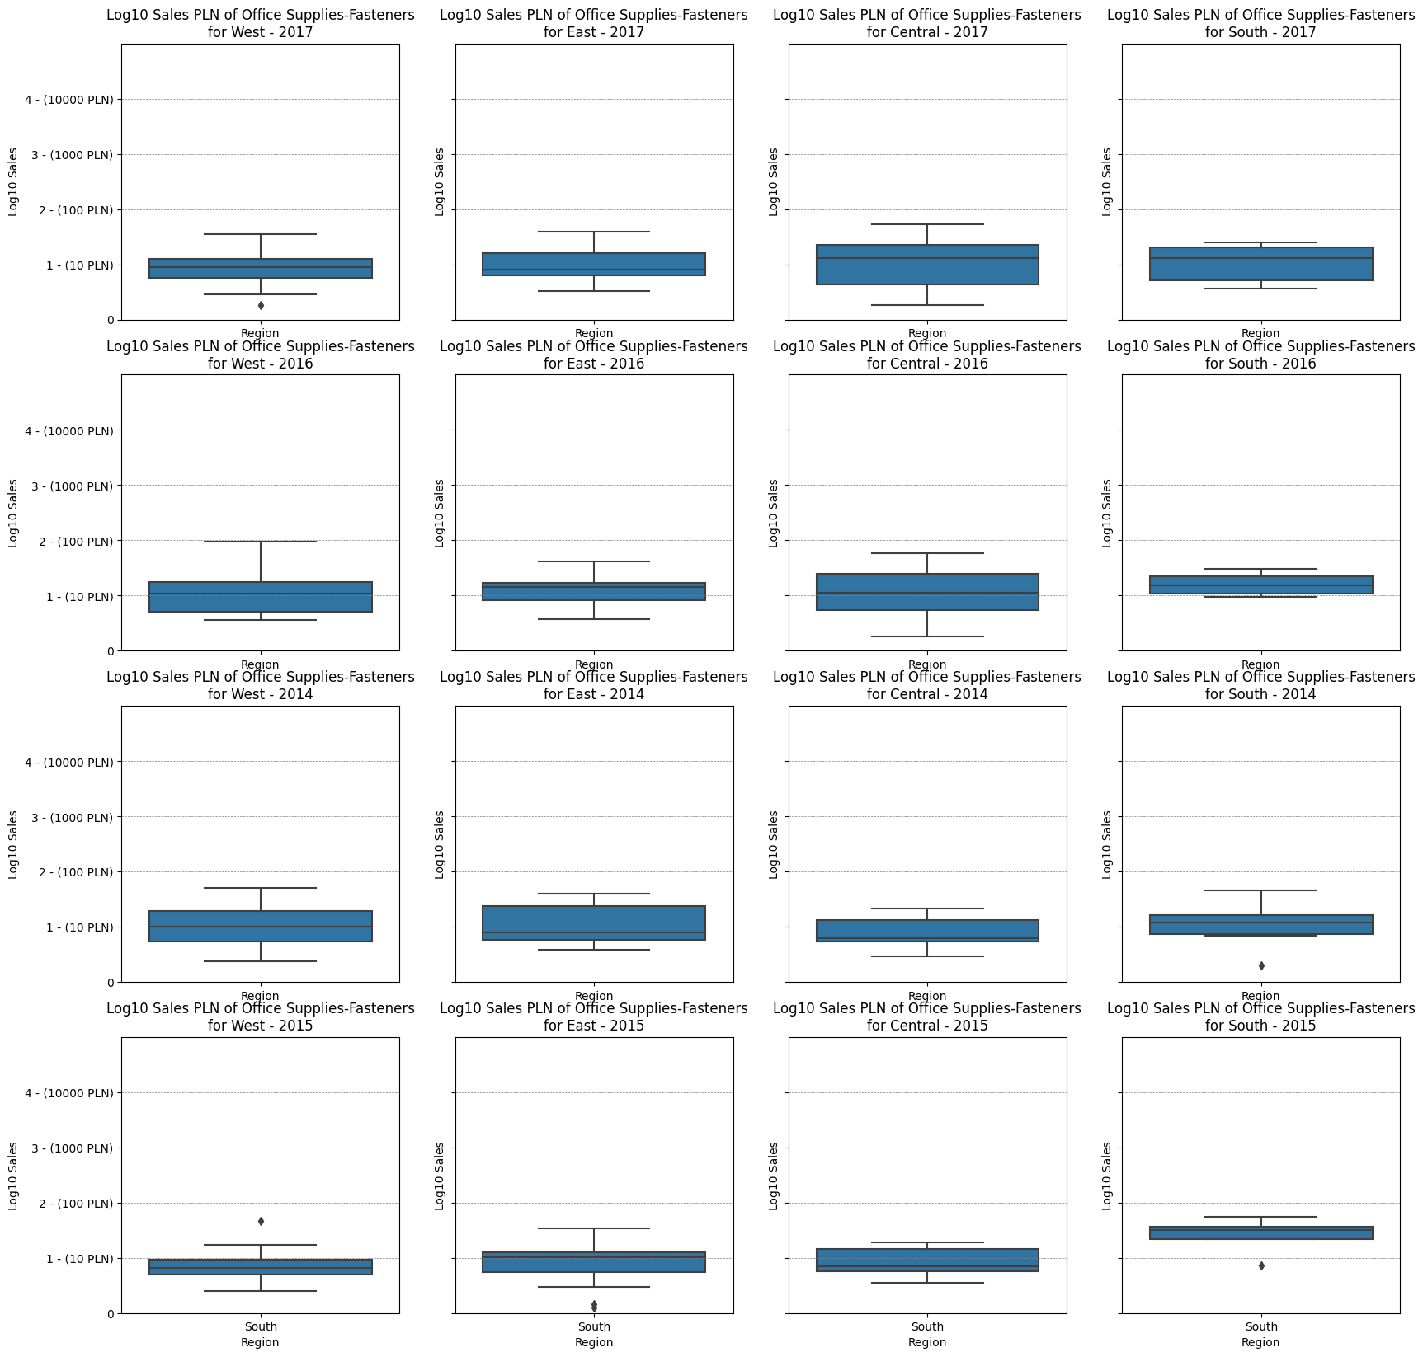
group1 | group2 | meandiff | p-adj | lower | upper | reject
Office Supplies-Fasteners-Central | Office Supplies-Fasteners-East | -0.0428 | 1.0 | -0.8312 | 0.7456 | False
Office Supplies-Fasteners-Central | Office Supplies-Fasteners-South | -0.02 | 1.0 | -0.9783 | 0.9383 | False
Office Supplies-Fasteners-Central | Office Supplies-Fasteners-West | -0.1123 | 1.0 | -0.8221 | 0.5974 | False
Office Supplies-Fasteners-East | Office Supplies-Fasteners-South | 0.0228 | 1.0 | -0.9645 | 1.0102 | False
Office Supplies-Fasteners-East | Office Supplies-Fasteners-West | -0.0695 | 1.0 | -0.818 | 0.6789 | False
Office Supplies-Fasteners-South | Office Supplies-Fasteners-West | -0.0924 | 1.0 | -1.0181 | 0.8333 | False

Slide 19
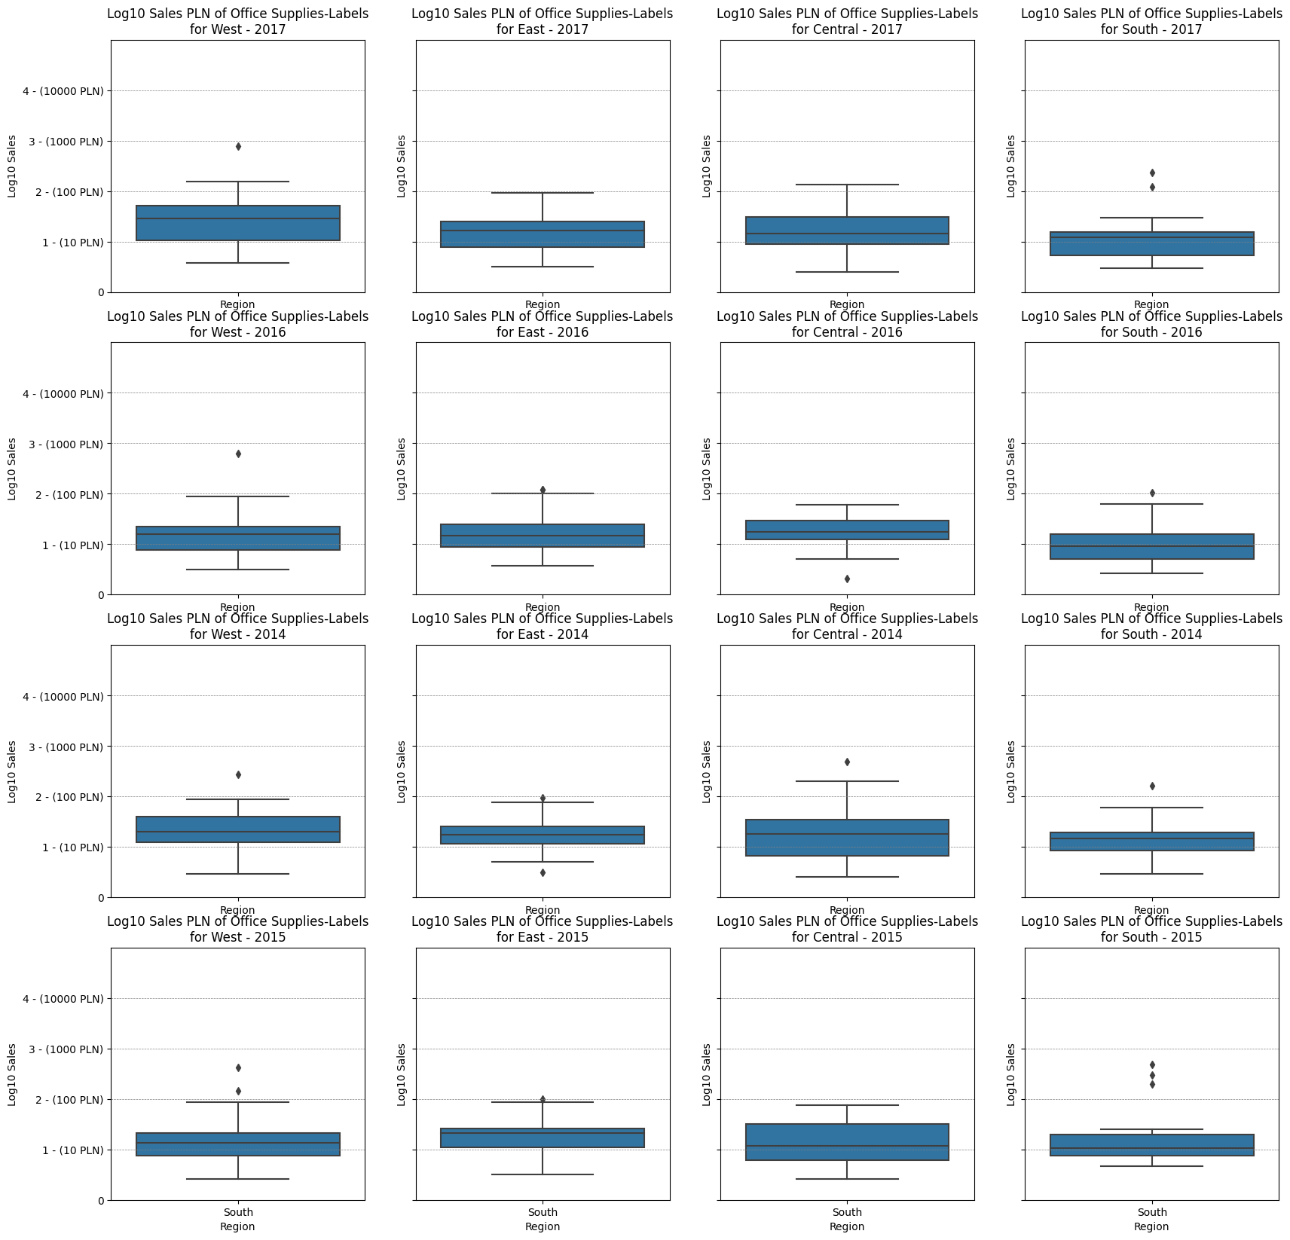
group1 | group2 | meandiff | p-adj | lower | upper | reject
Office Supplies-Labels-Central | Office Supplies-Labels-East | -0.0451 | 1.0 | -0.6439 | 0.5538 | False
Office Supplies-Labels-Central | Office Supplies-Labels-South | -0.1227 | 1.0 | -0.8218 | 0.5765 | False
Office Supplies-Labels-Central | Office Supplies-Labels-West | 0.19 | 1.0 | -0.4153 | 0.7954 | False
Office Supplies-Labels-East | Office Supplies-Labels-South | -0.0776 | 1.0 | -0.7141 | 0.5589 | False
Office Supplies-Labels-East | Office Supplies-Labels-West | 0.2351 | 1.0 | -0.2967 | 0.7669 | False
Office Supplies-Labels-South | Office Supplies-Labels-West | 0.3127 | 0.9999 | -0.33 | 0.9554 | False

Slide 20
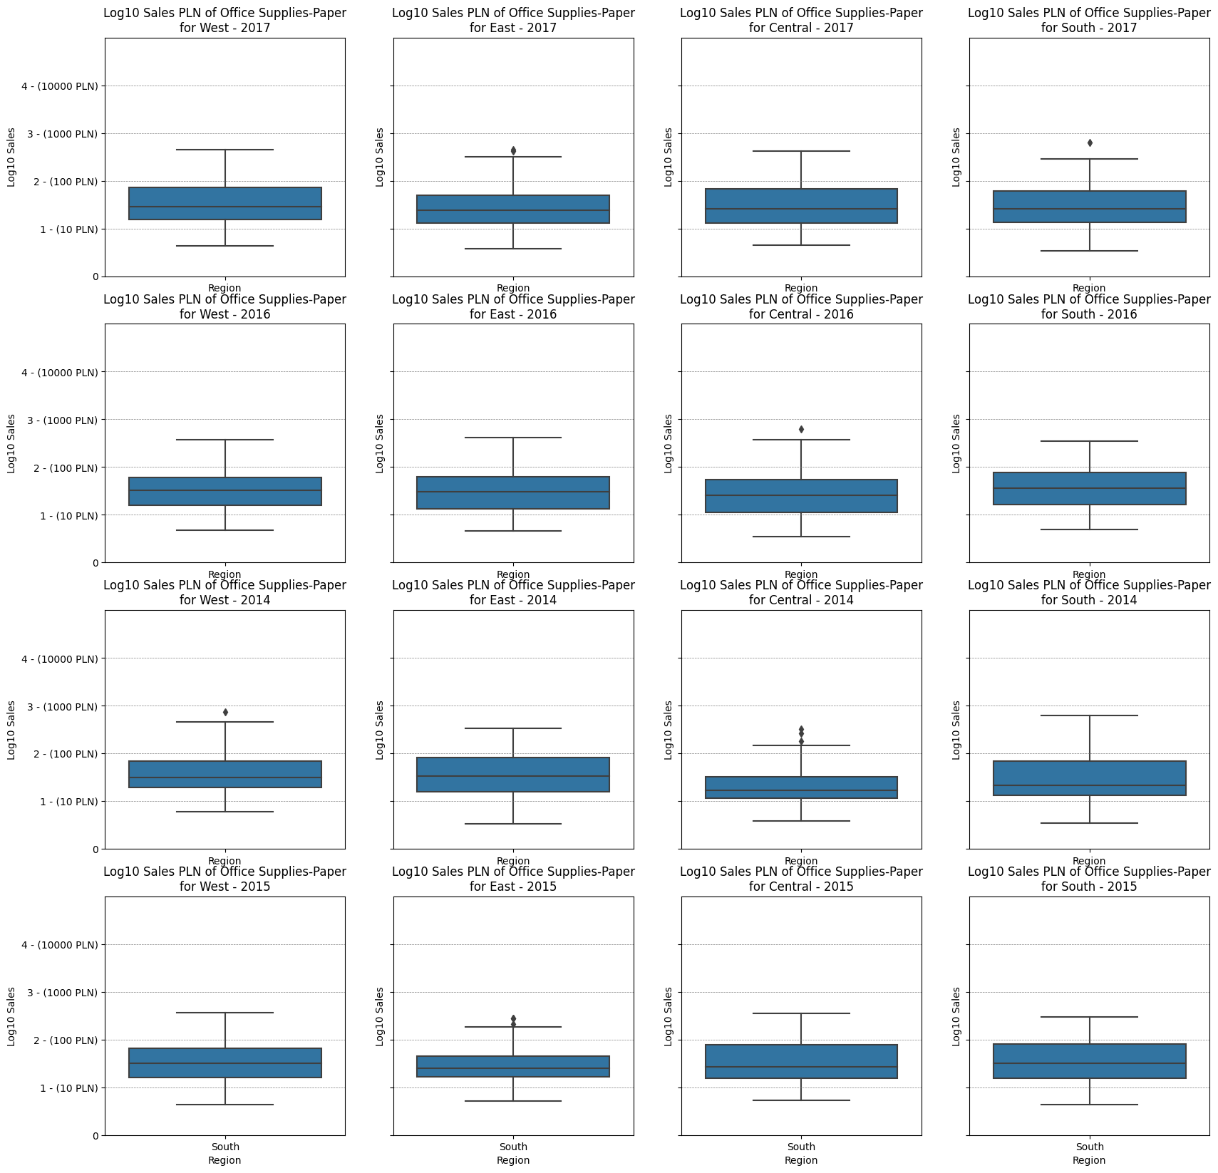
group1 | group2 | meandiff | p-adj | lower | upper | reject
Office Supplies-Paper-Central | Office Supplies-Paper-East | -0.0212 | 1.0 | -0.3106 | 0.2683 | False
Office Supplies-Paper-Central | Office Supplies-Paper-South | 0.0367 | 1.0 | -0.3118 | 0.3852 | False
Office Supplies-Paper-Central | Office Supplies-Paper-West | 0.0543 | 1.0 | -0.2316 | 0.3402 | False
Office Supplies-Paper-East | Office Supplies-Paper-South | 0.0579 | 1.0 | -0.2767 | 0.3924 | False
Office Supplies-Paper-East | Office Supplies-Paper-West | 0.0755 | 1.0 | -0.1932 | 0.3442 | False
Office Supplies-Paper-South | Office Supplies-Paper-West | 0.0176 | 1.0 | -0.3139 | 0.3491 | False

Slide 21
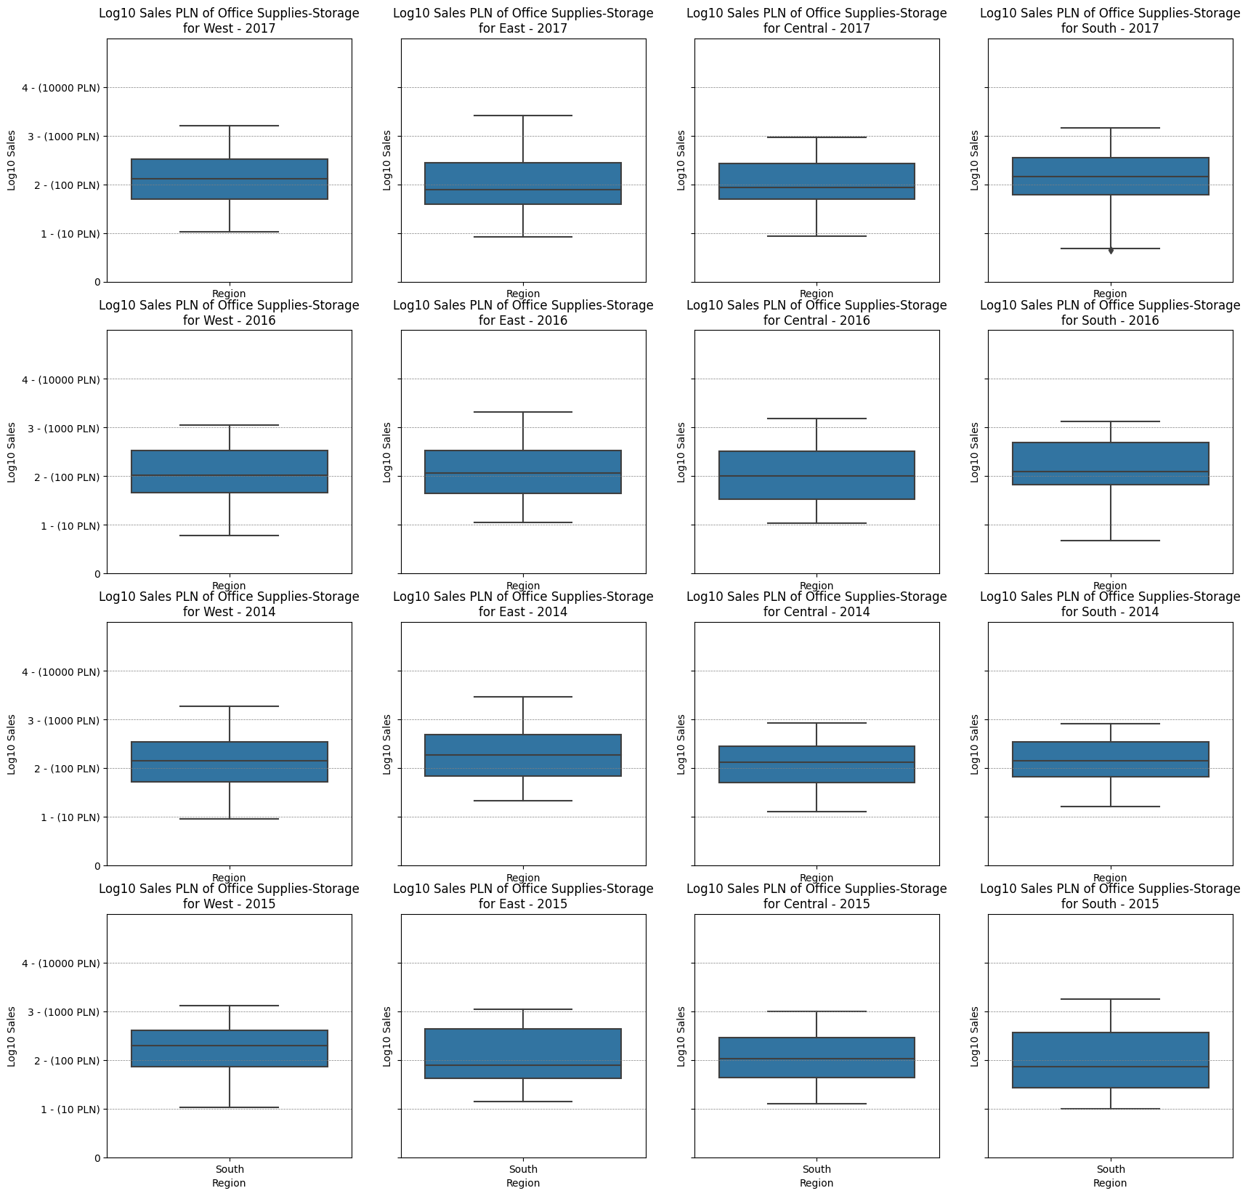
group1 | group2 | meandiff | p-adj | lower | upper | reject
Office Supplies-Storage-Central | Office Supplies-Storage-East | 0.034 | 1.0 | -0.338 | 0.4061 | False
Office Supplies-Storage-Central | Office Supplies-Storage-South | 0.1076 | 1.0 | -0.336 | 0.5513 | False
Office Supplies-Storage-Central | Office Supplies-Storage-West | 0.0975 | 1.0 | -0.2489 | 0.444 | False
Office Supplies-Storage-East | Office Supplies-Storage-South | 0.0736 | 1.0 | -0.369 | 0.5162 | False
Office Supplies-Storage-East | Office Supplies-Storage-West | 0.0635 | 1.0 | -0.2816 | 0.4086 | False
Office Supplies-Storage-South | Office Supplies-Storage-West | -0.0101 | 1.0 | -0.4314 | 0.4112 | False

Slide 22
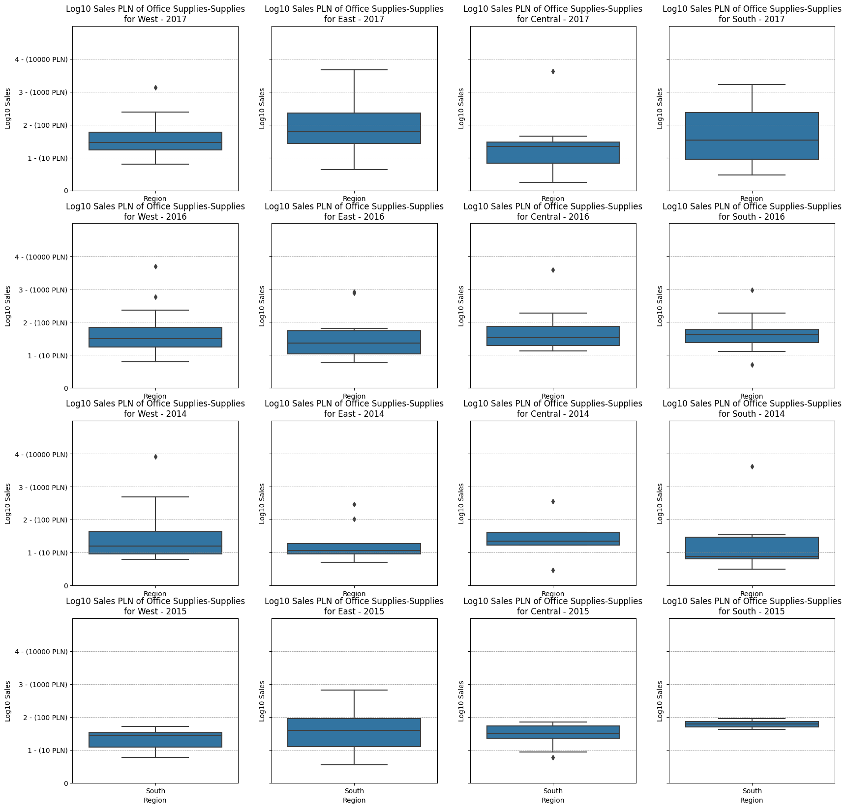
group1 | group2 | meandiff | p-adj | lower | upper | reject
Office Supplies-Supplies-Central | Office Supplies-Supplies-East | 0.5907 | 0.7429 | -0.2129 | sty.44 | False
Office Supplies-Supplies-Central | Office Supplies-Supplies-South | 0.3362 | 1.0 | -0.6274 | sty.97 | False
Office Supplies-Supplies-Central | Office Supplies-Supplies-West | 0.2599 | 1.0 | -0.5437 | 1.0636 | False
Office Supplies-Supplies-East | Office Supplies-Supplies-South | -0.2545 | 1.0 | -1.1753 | 0.6662 | False
Office Supplies-Supplies-East | Office Supplies-Supplies-West | -0.3308 | 1.0 | -1.0826 | 0.4209 | False
Office Supplies-Supplies-South | Office Supplies-Supplies-West | -0.0763 | 1.0 | -0.997 | 0.8445 | False

Slide 23
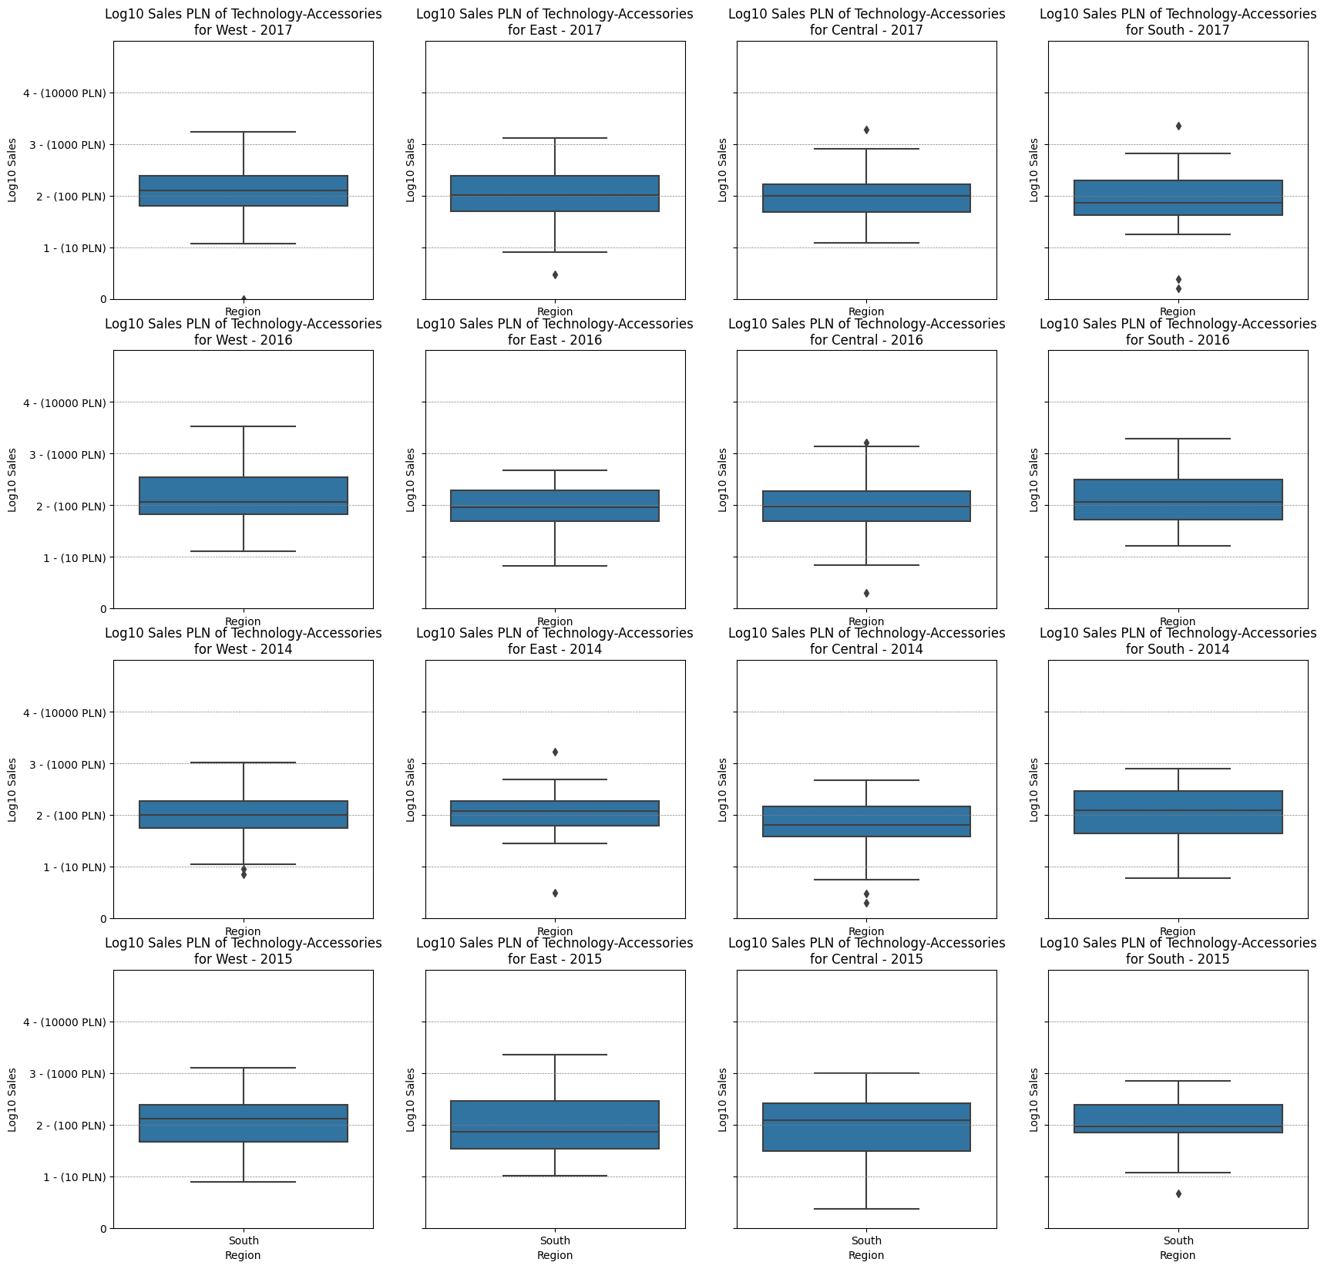
group1 | group2 | meandiff | p-adj | lower | upper | reject
Technology-Accessories-Central | Technology-Accessories-East | -0.0018 | 1.0 | -0.3895 | 0.3859 | False
Technology-Accessories-Central | Technology-Accessories-South | -0.1093 | 1.0 | -0.5615 | 0.3429 | False
Technology-Accessories-Central | Technology-Accessories-West | 0.1233 | 1.0 | -0.2459 | 0.4926 | False
Technology-Accessories-East | Technology-Accessories-South | -0.1075 | 1.0 | -0.5411 | 0.3261 | False
Technology-Accessories-East | Technology-Accessories-West | 0.1252 | 1.0 | -0.2211 | 0.4715 | False
Technology-Accessories-South | Technology-Accessories-West | 0.2327 | 0.9974 | -0.1846 | 0.6499 | False

Slide 24
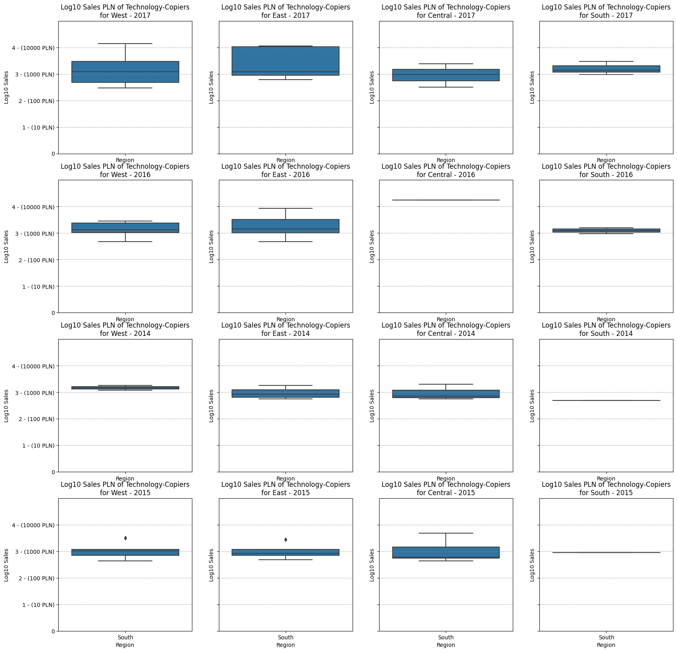
group1 | group2 | meandiff | p-adj | lower | upper | reject
Technology-Copiers-Central | Technology-Copiers-East | 0.4205 | 1.0 | -1.2265 | 2.0675 | False
Technology-Copiers-Central | Technology-Copiers-South | 0.246 | 1.0 | -1.5954 | 2.0874 | False
Technology-Copiers-Central | Technology-Copiers-West | 0.1836 | 1.0 | -1.2854 | sty.25 | False
Technology-Copiers-East | Technology-Copiers-South | -0.1746 | 1.0 | -1.8216 | sty.25 | False
Technology-Copiers-East | Technology-Copiers-West | -0.237 | 1.0 | -1.4534 | 0.9794 | False
Technology-Copiers-South | Technology-Copiers-West | -0.0624 | 1.0 | -1.5314 | sty.65 | False

Slide 25
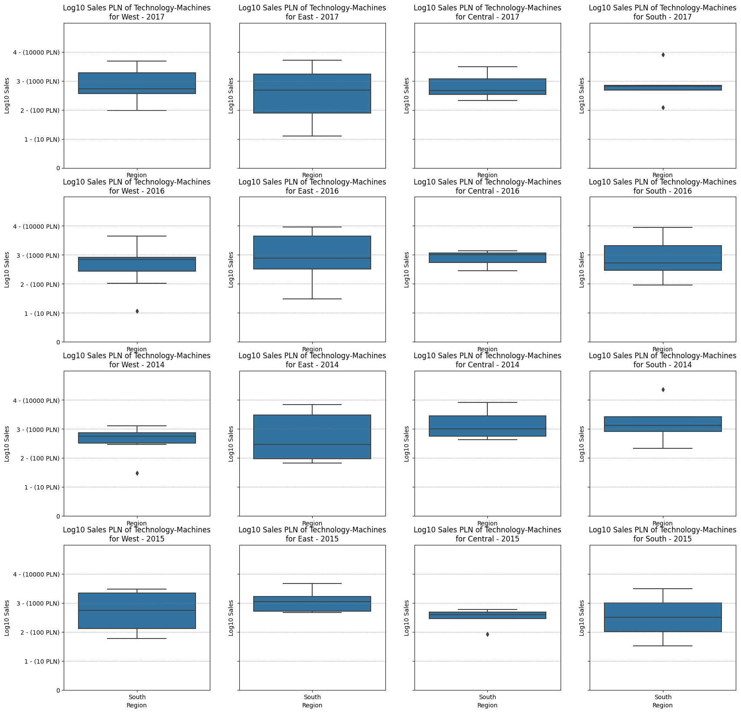
group1 | group2 | meandiff | p-adj | lower | upper | reject
Technology-Machines-Central | Technology-Machines-East | -0.2387 | 1.0 | -1.4273 | 0.9499 | False
Technology-Machines-Central | Technology-Machines-South | 0.0612 | 1.0 | -1.3044 | sty.68 | False
Technology-Machines-Central | Technology-Machines-West | 0.0459 | 1.0 | -1.0672 | 1.159 | False
Technology-Machines-East | Technology-Machines-South | 0.2999 | 1.0 | -0.958 | sty.78 | False
Technology-Machines-East | Technology-Machines-West | 0.2846 | 1.0 | -0.6934 | sty.25 | False
Technology-Machines-South | Technology-Machines-West | -0.0153 | 1.0 | -1.2021 | 1.1715 | False

Slide 26
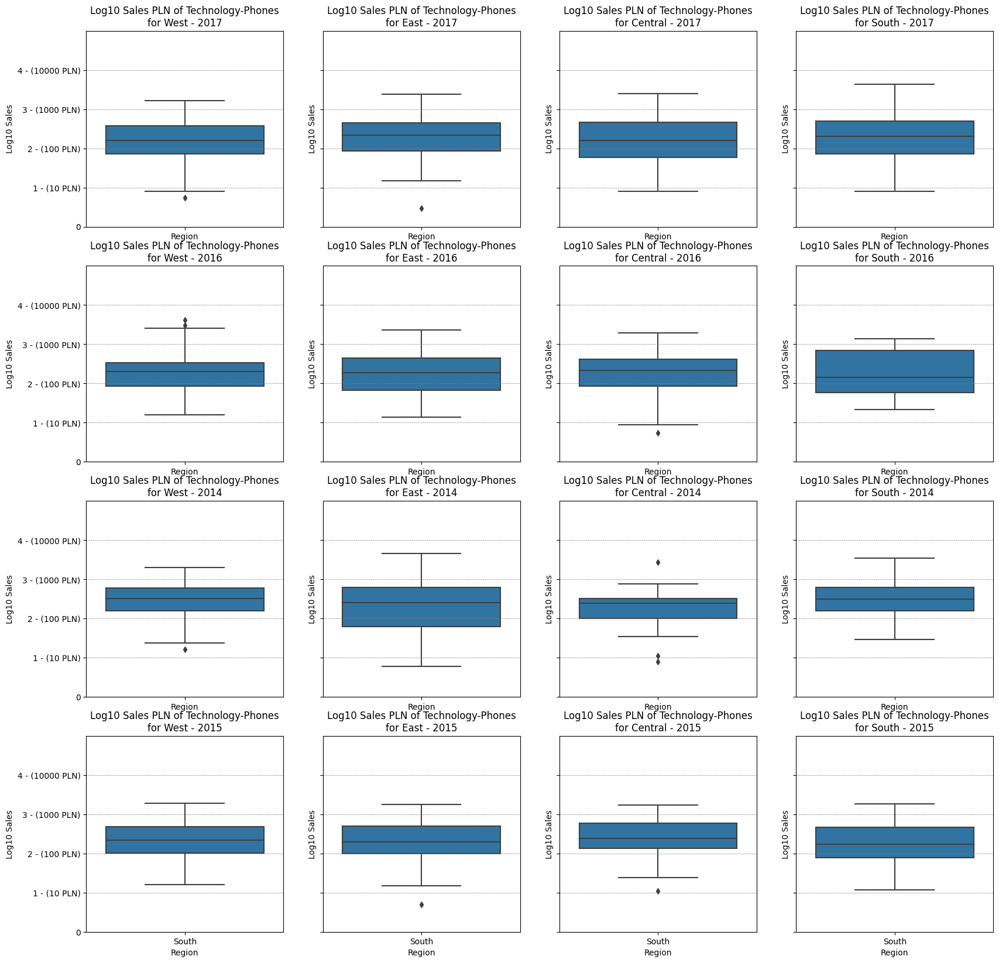
group1 | group2 | meandiff | p-adj | lower | upper | reject
Technology-Phones-Central | Technology-Phones-East | 0.0554 | 1.0 | -0.3197 | 0.4304 | False
Technology-Phones-Central | Technology-Phones-South | 0.0204 | 1.0 | -0.4222 | 0.463 | False
Technology-Phones-Central | Technology-Phones-West | -0.0645 | 1.0 | -0.4418 | 0.3128 | False
Technology-Phones-East | Technology-Phones-South | -0.035 | 1.0 | -0.4365 | 0.3665 | False
Technology-Phones-East | Technology-Phones-West | -0.1199 | 1.0 | -0.448 | 0.2083 | False
Technology-Phones-South | Technology-Phones-West | -0.0849 | 1.0 | -0.4885 | 0.3187 | False

